Slide 1
Federation of Ethiopian Associations of Person with Disability /FEAPD/
September, 2022
Addis Ababa, Ethiopia

Slide 2
Outline of the presentation
Part 1: FEAPD Profile
Part 2: FEAPD high level achievements
Part 3: FEAPD – Save the Children partnership project achievements
Part 4: IDPD and COVID-19 emergency project
Part 5: Opportunities and Challenge

Slide 3
Current Organizational Overview:
Legal Status and Identity:
The Federation of Ethiopian Associations of Persons with Disabilities (FEAPD) is a consortium of organizations of persons with disabilities in Ethiopia established in 1996
FEAPD is a legally re-registered in accordance with Civil Societies Agency Proclamation No. 1113/2019 as Consortium of Association.

Slide 4
Organizational Overview:
FEAPD’s Vision:
FEAPD aspires to see where all persons with disabilities are effectively included on equal basis with others.;
FEAPD’s Mission:
To promote the overall participation of persons with disabilities in the society by bringing the member associations together, serving as their common voice by representing them at national, continental, global level, by consolidating their common effort, by establishing strong relationship with their strategic partners, working together and build their capacity.

Slide 5
FEAPD Core Values:
Organizational Overview:
FEAPD adheres the following core values;
Transparency
Gender Equality
Trust Worthiness
Equality
The right to respect self-decision
Inclusion
Professionalism

Slide 6
Afar Association of Persons with Disabilities
The Ethiopian National Association of the Blind (ENAB)
FEAPD Member Associations are:
Harar Union of Persons with Disabilities
Benishangul Gumuz Association of Persons with Disabilities
Accessible Ethiopia
Diredawa Union of Associations of Persons with Disabilities
Addis Hiwot Center for The Blind
Amhara Region of Associations of Persons with Disabilities
Tigray forum of Associations of Persons with Disabilities
The Ethiopian National Association of the Deaf (ENAD)
The Fikir Ethiopia National Association on Intellectual Disability (FENAID)
Sidama Region Union of Associations of Persons with Disabilities
Hope for the Blind and Handicapped Rehabilitating Association
Gambella region Association of Persons with Disabilities
Oromia region of Persons with Disability Associations
The Ethiopian National Association of Persons Affected by Leprosy (ENAPAL)
SNNP Region Union of Associations of Persons with Disabilities
Ethiopian Lawyers with Disabilities Association
The Ethiopian Women with Disabilities National Association (EWDNA)
Fana Versatile Disabilities Organization
Finot Rehabilitation for Women with Disabilities Association
The Ethiopian National Association of the Deaf-Blind (ENADB)
Ethiopia
Equal Opportunity Association of Women with Disabilities living with HIV/AIDS
The Ethiopian National Development Association of Persons with Physical Disabilities (ENDAPPD)
Somali Region Federation of Associations of Persons with Disabilities
South West Ethiopia Peoples Region Union of Associations of Persons with Disabilities
FEAPD

Slide 7
FEAPD objectives
Enhance the public awareness on disability and persons with disabilities,
Enhance the institutional capacities of OPDs and other stakeholders in addressing disability issues,
Promoting inclusive education
Promoting health HIV/AIDS services for persons with disabilities
Economically empowering persons with disabilities, women, children & youth development
Advocate the rights of persons with disabilities,
Promote disability right movement
Conduct emergency response activities
Initiating and promoting research in the area of disability and access information
Participating in continental and global disability alliance.
Improve the availability of disability related information,
Mobilize resources used to address disability related challenges in the country.
Strengthen partnership and collaboration.
Reduce the disability information gaps in the country,

Slide 8
FEAPD Programmatic Area
Capacity Building
Advocacy
Inclusive Education
Inclusive Health
Awareness Raising
Economic Empowerment
Humanitarian & Emergency Response
Gender And Inclusion
Legal Advisory
Livelihood
WASH
Resource Mobilization And Fundraising
Partnership And Membership
TVET and Vocational Training

Slide 9
FEAPD
54 Generally Assembly
9 board
11 Management and 17 professional project team,27 technical staff
17 legal advisors
165 voluntary from the 33 OPDs

Slide 10
FEAPD Policy and Manuals
No | Name of Policies and Manuals | Date of issued/updated
1 | Five Years Strategic plan | February, 2019
2 | Advocacy and communication strategy | December, 2019
3 | Code of conduct policy | July, 2019
4 | Finance Manual | August, 2021
5 | Fraud Awareness and protection policy | September, 2019
6 | Gender Mainstreaming Manual | August, 2020
7 | Grants Management Manual | March, 2021
8 | A Guideline for victim Assistance and principles | May, 2020
9 | The human resource procedure manuals | August, 2021

Slide 11
No | Name of Policies and Manuals | Date of issued/updated
10 | By-law | August, 2019
11 | Procurement policy manual | May, 2022
12 | Whistle Blowing Concept and Policy | January, 2021
13 | Safeguarding Policy of Child and Adult at risk | May, 2022
14 | Protection from Sexual Exploitation and Abuse Policy | November, 2020
15 | Annual Training Plan for Prevention Sexual Exploitation Abuse | May, 2022
16 | Awareness creation plan on PSEA | Feb, 2022
17 | Preventing and responding to sexual exploitation and Abuse (PSEA) Training Package | January, 2022
18 | Disability Inclusive TOT manual | December, 2021

Slide 12
Donors & Implementing partners
Current Donors of FEAPD:
ILO
UNOHCHR
CBM
NORAD
EU
NFU
USAID and
ADF
UKAID
In addition to that FEAPD worked with many implementing partners such as:
CSSP Stakeholders from Government Organization
LFTW
SCI
HI and
NDI.

Slide 13
FEAPD Active Project 92,077,398 ETB
Donor Name | Project Name | Project Area | Project Period
CBM | Empowering FEAPD and its Member OPDs in Creating Disability Inclusive Society in Ethiopia | 9 regions and 2 city administration (Amhara, Tigray, Gambella, Benishangul Gumuz, Afar, SNNP, Sidama, Harari and Somali regional states and Addis Ababa city administration and Diredawa city administration) | January 1, 2022 – December 31, 2024
Ministry of Foreign affairs of Netherlands | We Are Abel/The Power of Voice | Oromia Regional State (Babile, Deder, Haromaya, Gursum woredas), Harari Regional State, Diredawa City Administration and Addis Ababa City Administration | From January 2021 to December 2025
European Union | Disability Rights for Increased Voice & Empowerment (DRIVE) in Ethiopia | Amhara (Bahirdar, D/markos & Gondar) & SNNPR | January 2020 to February 2023
USAID | Enhancing enabling environment through engagement of duty bears to realize the fundamental human rights of persons with disability | Oromiya, SNNP, Sidama, Amhara and AA city administration | March 15, 2021-June 30, 2022

Slide 14
Donor Name | Project Name | Project Area | Project Period
TOFI | Together for inclusion | Together for inclusion | Oromiya, SNNPR, , Amhara and AA city adminstration
CSSP2 | Enhancing the capacity of OPDs to create an inclusive society in Ethiopia | Enhancing the capacity of OPDs to create an inclusive society in Ethiopia | ArbaMinch, Wolayita and Shashemenie
NORAD | Health, education, and livelihood Africa, a sustainable inclusive approach. | Health, education, and livelihood Africa, a sustainable inclusive approach. | Hawasa and Sidama region
Save the Children | Advancing accountability to ensure children rights in Ethiopia | Advancing accountability to ensure children rights in Ethiopia | AA
Light for the World | empowering FEAPD and its Member OPDs in Creating Disability Inclusive Society in Ethiopia | empowering FEAPD and its Member OPDs in Creating Disability Inclusive Society in Ethiopia | ArbaMinch, Gorese, Sodo town and Boloso Sore
UKAID | Economic empowerment of women PWDs | Economic empowerment of women PWDs | Debrebirhan

Slide 15
Some of the high level achievements of FEAPD
Participated in the CRPD negotiation at the UN level
Lobbied the government and succeeded in having the convention ratified by Ethiopia
Pushed for the establishment of the national implementation and steering committee of the convention and is serving as general secretary of the committee
Pushed for legislation on employment rights of persons with disabilities, participate on disability act ratification process and national education road map for inclusion of children with disabilities
Strengthen the capacity of its member OPDs
Executed and implanting successful disability oriented projects in collaboration with its several partners

Slide 16
Cont..
FEAPD contributed to the draft directive of freight transportation by enforcing Ministry of Transportation and driving license for the deaf was allowed in Ethiopia
FEAPD enforced and provided feedback on the ten-year plan prepared by the Planning and Development Commission of Ethiopia to allocate additional budget for persons with disabilities in each sector
FEAPD provided feedback on the 10 years Education Sector Development Programme VI (ESDP VI) to be more friendly for persons with disabilities
FEAPD also emphasized that the HRC has to establish a desk that focuses on persons with disabilities and their rights in line with the UNCRPD
The issues of persons with disabilities are included in the electoral law of Ethiopia by the discussion of FEAPD with government authorities,
Pushed CSA and included Washington group questions for census

Slide 17
Cont..
The federation has played an essential role in the inclusion of disability issues in different proclamations, directives, and guidelines.
To mention some of the achievements the Civil Society Organizations’ Proclamation which has been proclaimed in 2019 has directly entertained the issues raised by FEAPD. In this proclamation, the push of FEAPD enabled the assignment of two representatives of persons with disabilities from FEAPD on the board
In addition, FEAPD has lobbied and pushed the civil society organizations authority to ensure all government and non-government institutions projects and programs are inclusive of persons with disabilities and this government body has included the agenda during the renewal of the new CSO law.

Slide 18
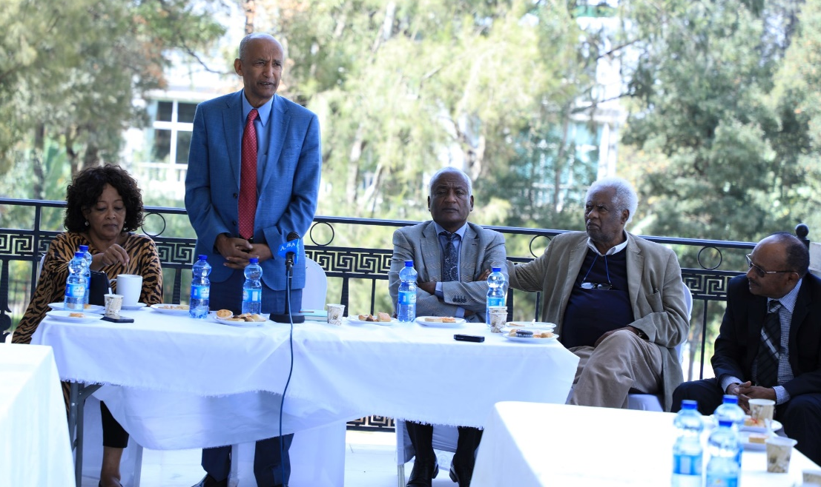
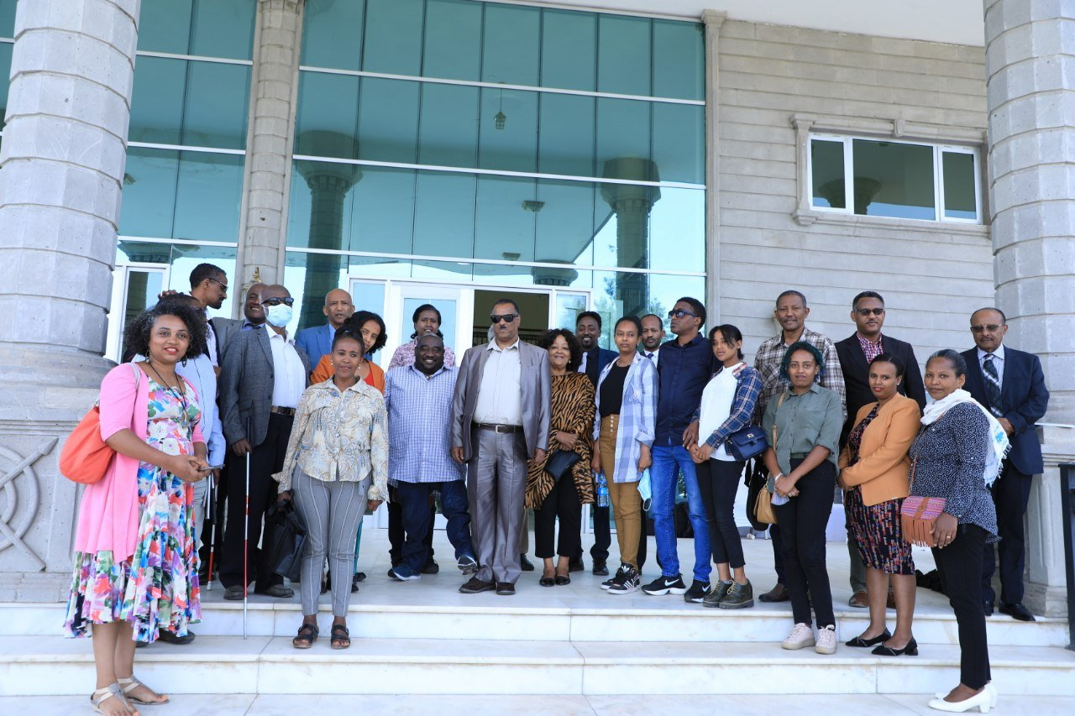
Participation on National Dialog

Slide 19
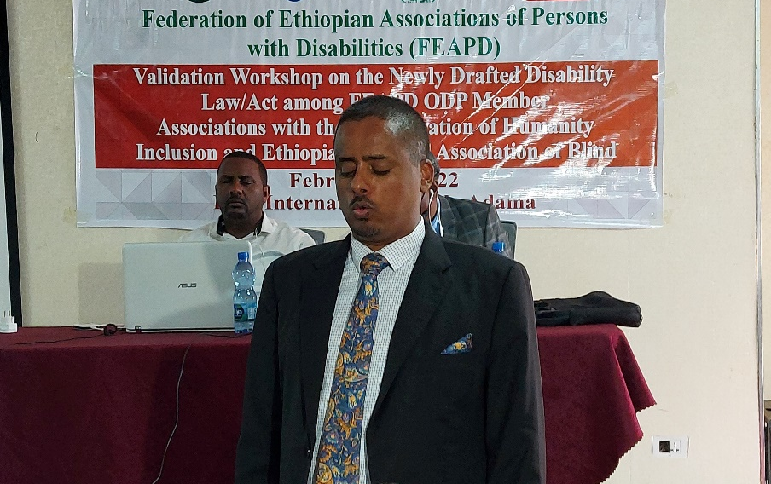
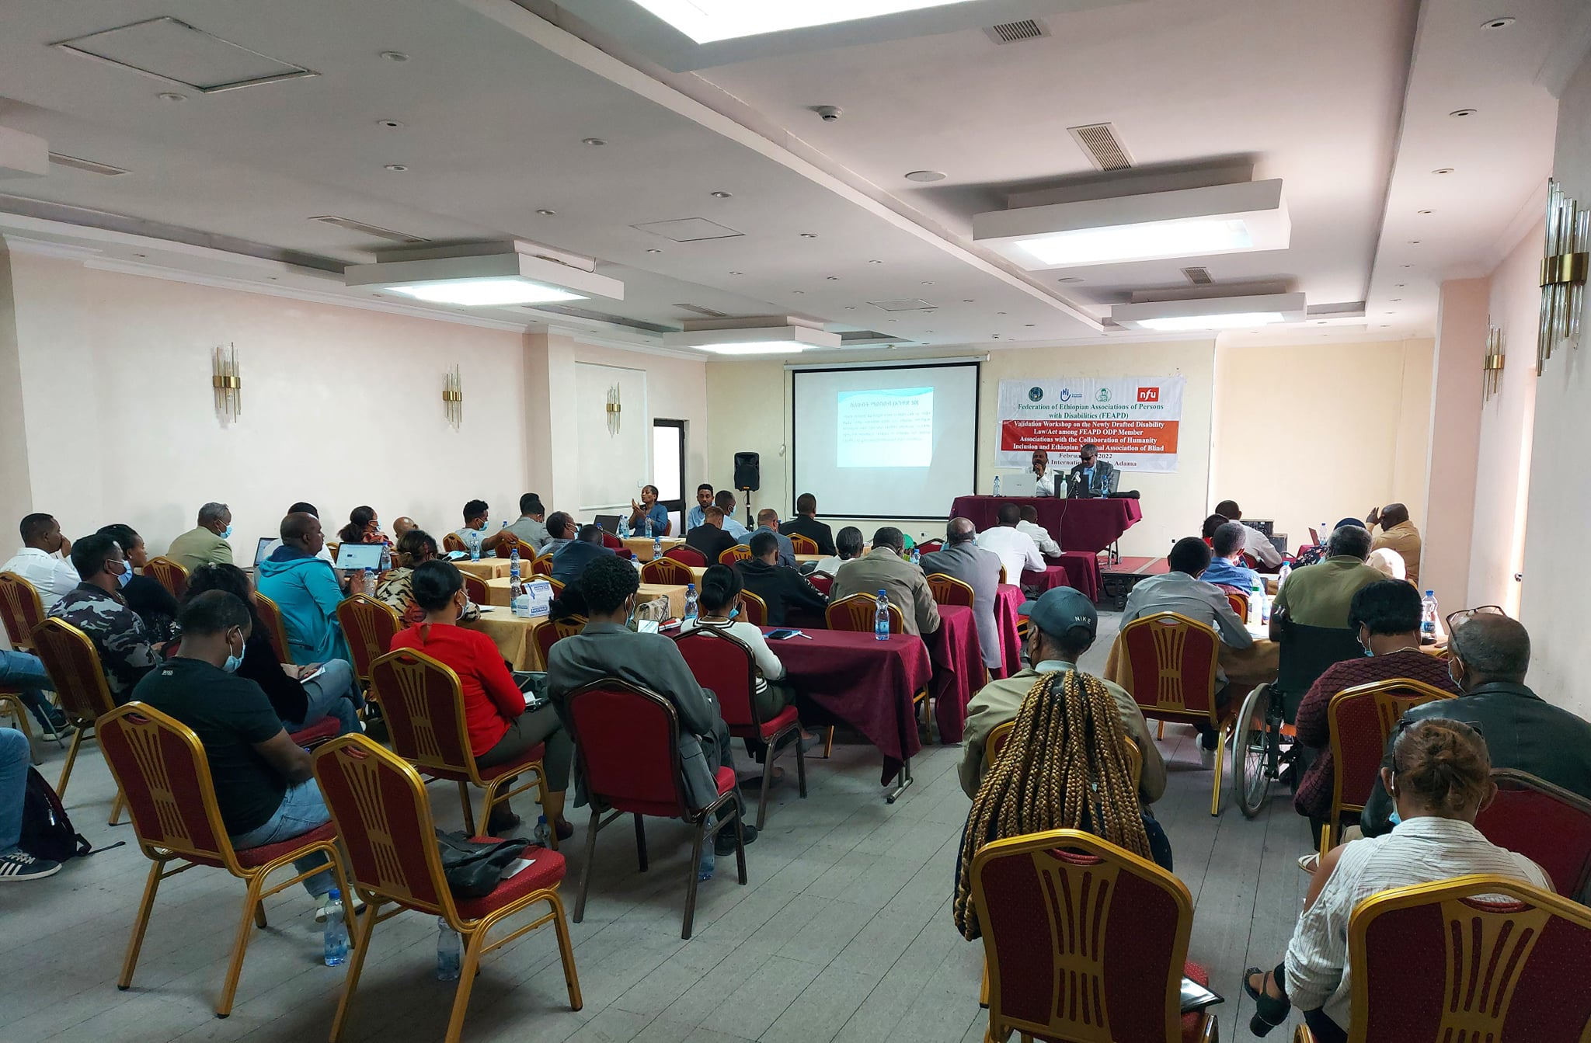
Cont..

Slide 20
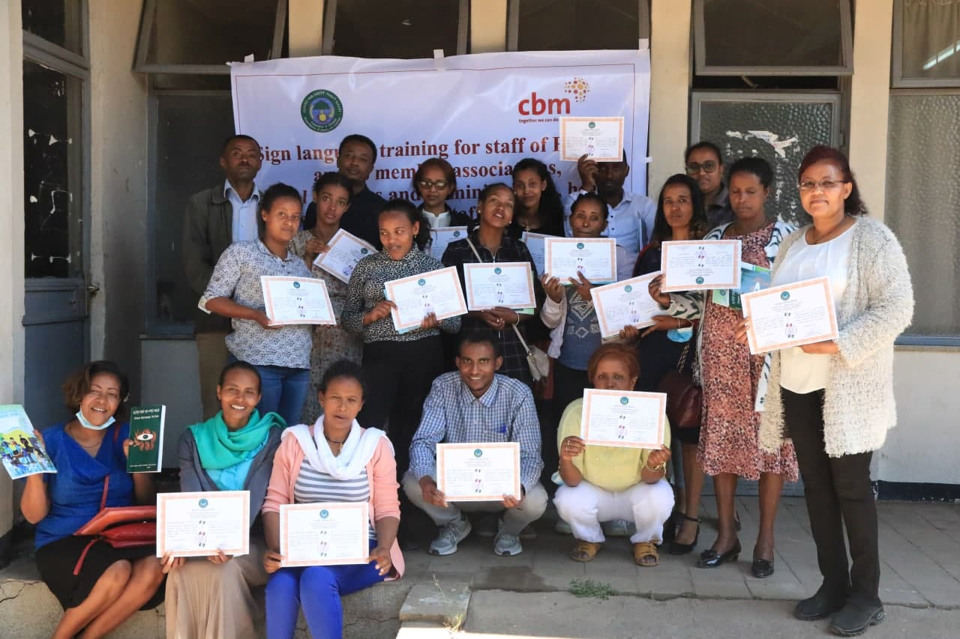
Cont..
FEAPD is working to ensure persons with disabilities' participation in political, social, economic and disability inclusive development programs
FEAPD has also worked on organizing different lobbying activities for the concerned government bodies for the ratification of the African Disability Protocol.
The awareness level of the community including persons with disabilities on disability inclusive development are enhanced (different capacity building trainings)
Sign language training

Slide 21
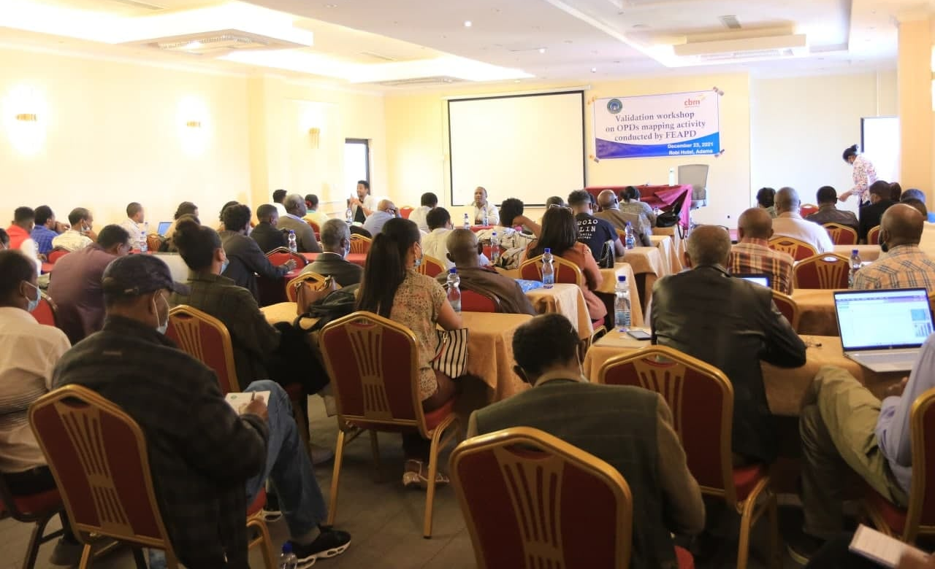
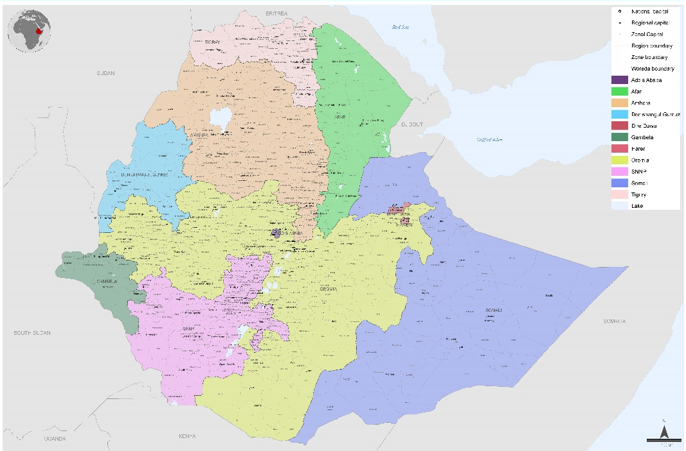
OPDs Mapping
FEAPD has developed a comprehensive OPDs database, recording general information about how many OPDs exist, where they are located, what they do, what services they provide, and to what extent they reach their target groups, collecting existing evidence on capacities and gaps of OPDs, particularly when it comes to advocacy and exchanging information between /among FEAPD and OPDs, purpose, aims, and opportunities for engagement, the mapping have taken about six months. The OPDs mapping has been conducted in 24 regional zones, towns and the two cities administrations except Tigry and Afar regions. These two regions are not included due to the conflict that has occurred in Ethiopia

Slide 22
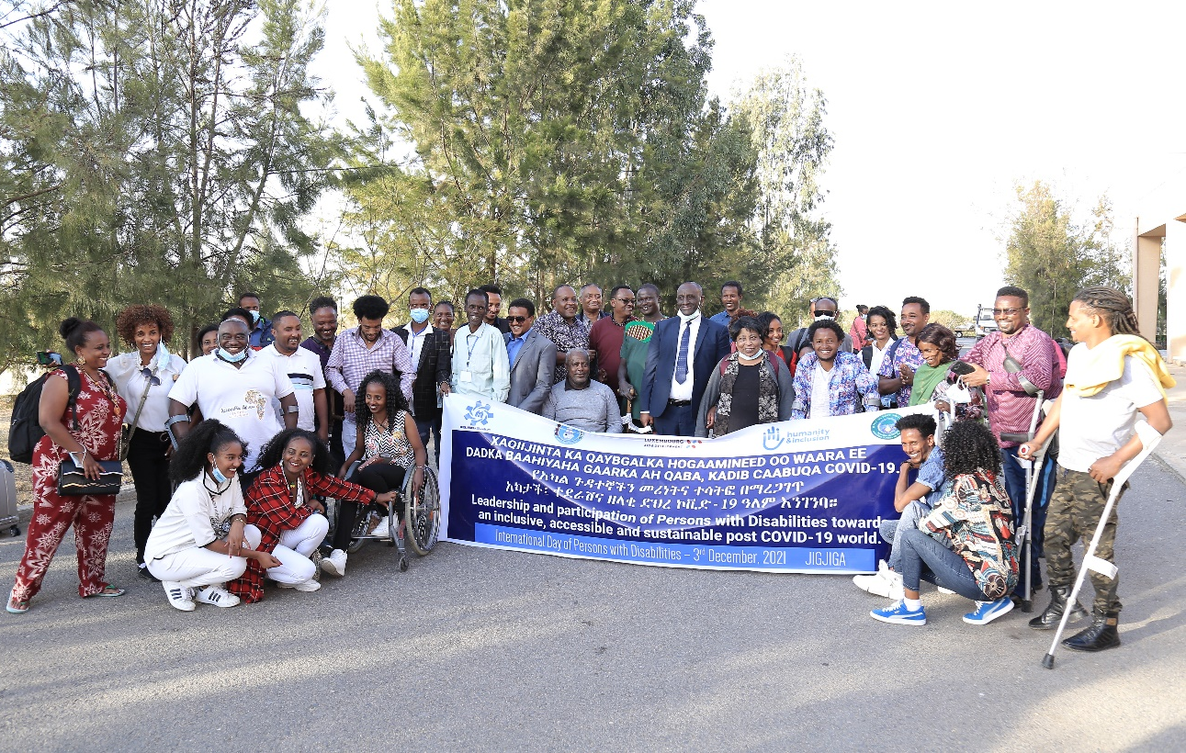
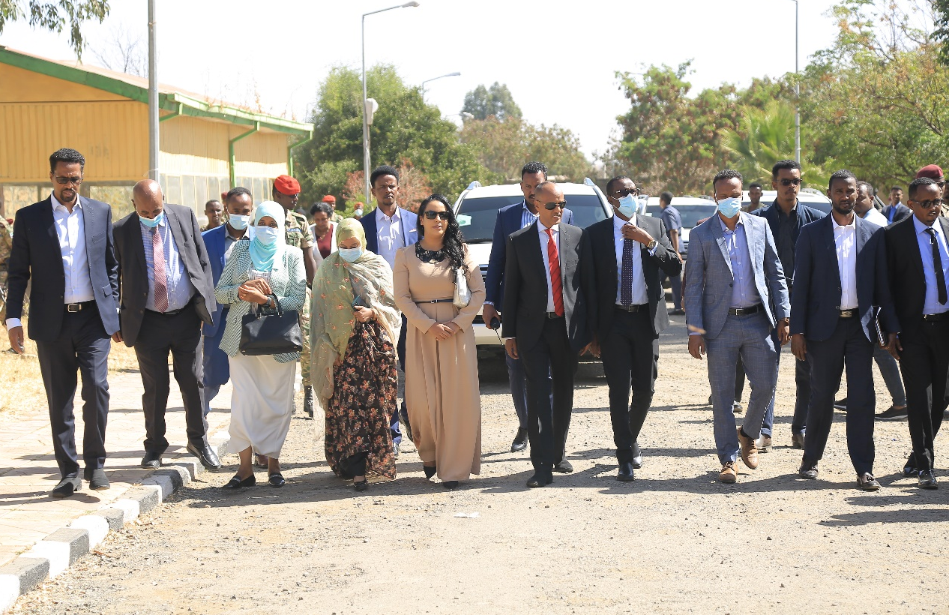
IDPD
The awareness raising about disability and disability inclusion through celebrating annual disability day and the published IEC material has improved the understanding of the society

Slide 23
COVID-19 emergency project
Number of TV and radio spots broadcasted and awareness is enhanced about COVID 19 through production and broadcasting of inclusive TV and Radio spots,
Printing and post an inclusive awareness-raising materials in different palaces
Persons with disabilities, women and elderly people who live in Addis Ababa, Hawassa, Bahir Dar and Adama have financially supported to fulfill their food and sanitary materials needs and they became survive at the time of the pandemic
Conducted accessibility audits at quarantine, isolation and treatment centers and shared the report to the Minister of health, the regional bureau of health and concerned government bodies.

Slide 24
Achievements of FEAPD-Save the Children partnership project
ADVANCING ACCOUNTABILITY TO ENSURE CHILDREN’S RIGHTS IN ETHIOPIA
Activity 1. Capacity building training to representatives’ of DPOs and mandated government ministry (MoLSA) on assessing the impact of legislations, policies and programs on children with disability (impact assessment) and mainstreaming issues of children with disabilities in government plans and programs.
Activity 2. Consultative workshop involving representatives of DPOs and government sectors on reviewing sectoral plans and programs in integrating issues of children with disability
Activity 3. Support FENAPD/DPO to advocate for increased budget allocation and spending for the inclusion of children with disability in major sectoral programs
Activity 4. Support children with disabilities (girls and boys) to actively participate in regional and district child parliaments to promote their rights and issues that need actions by government structures and stakeholders.

Slide 25
Cont..
DPOs, the Prime Minister Office, Ministry of Justice, Ministry of Education, Ministry of Women and Social Affairs, Ministry of Health, Ministry of Finance, Ministry of Plan, Ministry of Peace, Ministry of culture and sport, Ministry of Urban and Development, House of Peoples’ Representatives, House of Federation, Civil Society Organization Authority, Beuro of Women and Social Affairs of Addis Ababa city administration and Federal Police Commission
The total number of the conducted activities participants are 119. ( 8 were women with disabilities, 34 were women without disabilities, 5 of them are men with disabilities, 29 of them were men without disabilities and 43 children with different types of disabilities) this number includes assistants.
The conducted activities are created awareness about children with disabilities and inclusion (Biruh Tesfa radio)
Partnership have been established with government and other stakeholders
It was also improved the attitude of the participants about disability and the needs and challenges of children with disabilities.

Slide 26
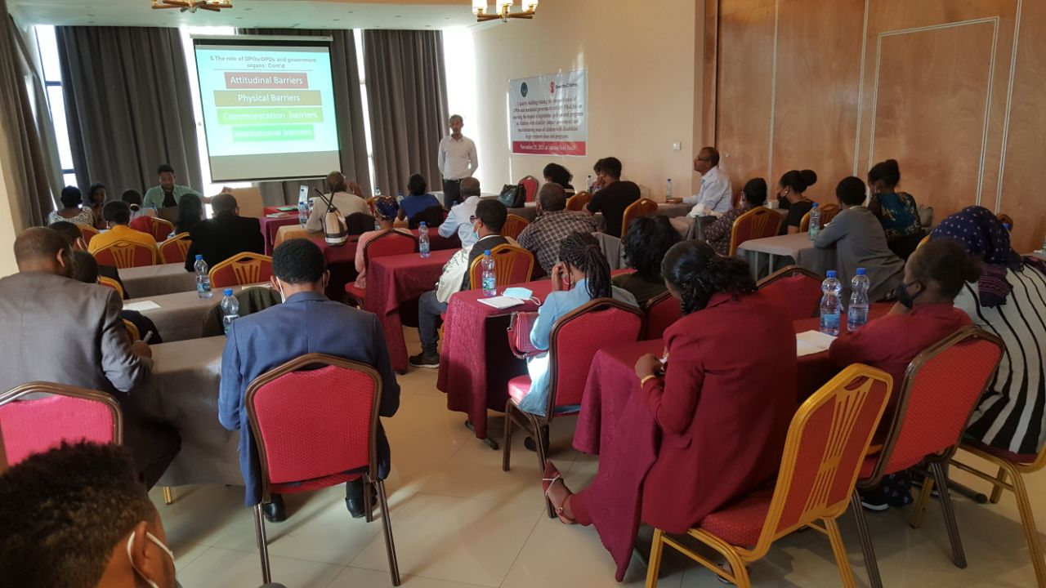
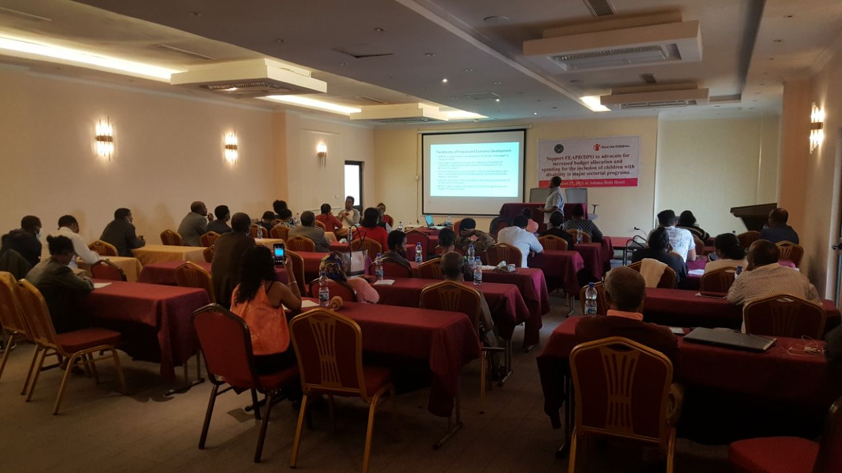

Slide 27
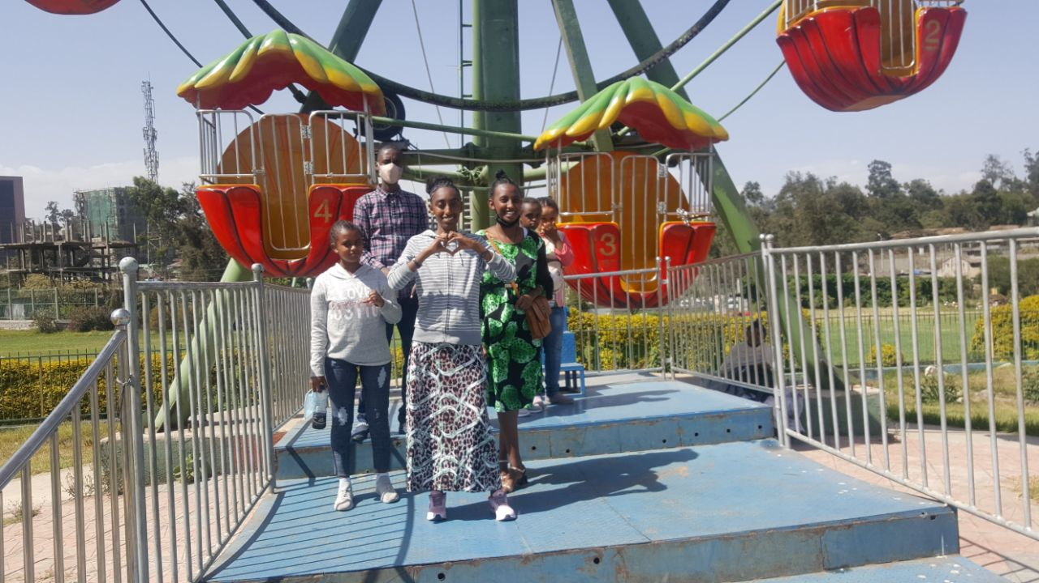

Slide 28
Opportunities and Challenges
We have 33 OPDs in all region of the countries and have OPDs in zonal and woreda as unions and associations of Persons With Disabilities
Ethiopian Disability act is on process.
CSOs proclamation number 1113/2019
UNCRPD , SDGs and African disability protocol to enforced and implemented all policies, and for the issues of advocacy
We are closely with the government and the level of acceptance is increase.
There are CSOs, indigenous NGOs, international NGOs who are worked on persons with disabilities and its number increased currently.
Development partners
The challenge is Restructuring of government ministries

Slide 29
THANK YOU VERY MUCH
FOR YOUR ATTENTION!
LEAVE NO ONE BEHIND!

