Slide 1

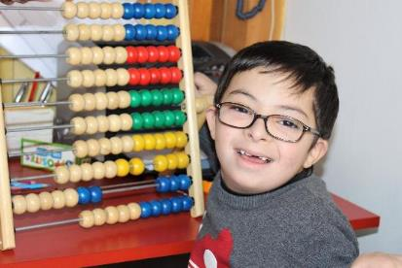
Save the Children’s Disability Accelerator Programme
Ethiopia
August 30-Sept 2, 2022
Please keep your microphones during presentations

Slide 2

The Facilitator team
Maggie SUN he.sun1@savethechildren.org
Disability Inclusion Senior Advisor Malawi;
Disability Inclusion Accelerator Program Global Lead
Member of Save the Children Disability Inclusion TWG
Started to work in the disability field since 2009, joined Save the Children in 2018 and worked as China Inclusive Education Advisor and Mekong Inclusive Education Advisor till end of 2020. Later worked as Inclusive Humanitarian Specialist and Chair of the Age and Disability Working Group in Cox’s Bazar for the Rohingya response in 2021.

Slide 3

Learning outcomes
Learning Outcomes
After the training, participants should be able to;
Understand concepts around disability, disability rights, inclusion and barriers
An awareness of discrimination faced by children with disabilities
Established a connection with OPDs
Gain knowledge and skills on disability inclusive programming

Slide 4
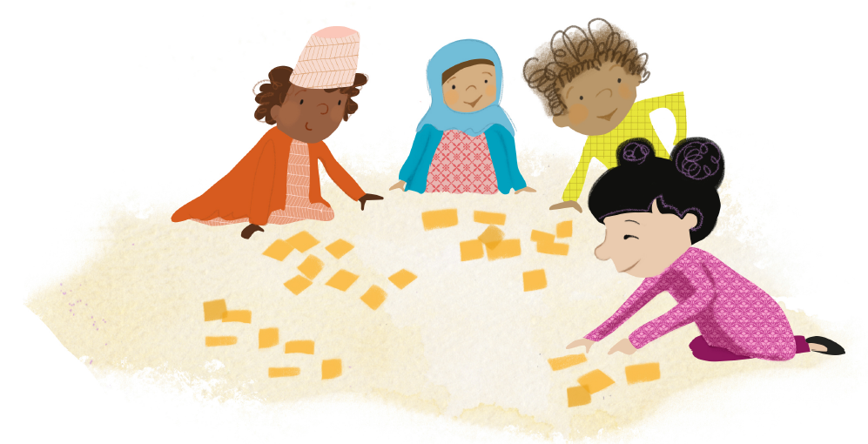
A. Take a few minutes… Please write on a piece of paper
What does disability mean to you?
Write your idea on a post it
No need to share, this is personal reflection.
Notes:
Ask everyone to do this on a paper in whichever language they want. The exercise is for participants to write something in the beginning of the training and then come back to it at the end. They should not share this or do anything with what they have written, only keep it

Slide 5
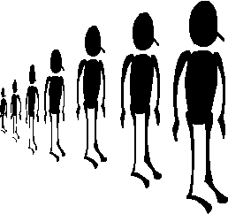
How much knowledge do you have on disability?
NO Knowledge
A LOT
Of Knowledge
ONE
TEN
Notes:
3 minutes
Activity:
Ask the group to place themselves on an imaginary line with ONE being the end where you are NOT Confident to include people with disabilities in your program and TEN being VERY Confident.
Discussion: ask people who are standing in different places why they are standing where they are
Can also ask if there is time: what would have you moving up towards other end of the line?
At the end of the webinar series, I will ask you to rate yourselves again to see if there has been any change in your confidence levels.

Slide 6

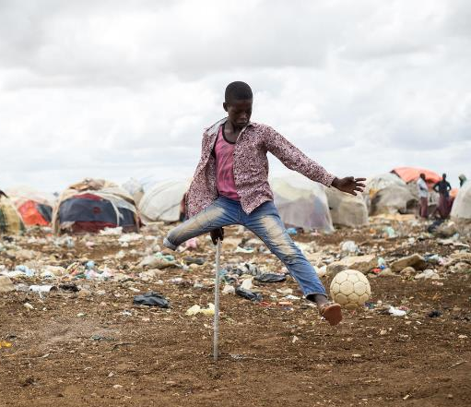
Session 1:
Save the Children’s
Disability Inclusion Policy
Notes:
This module is about the uplift to children with disabilties in Save the Children. If the training is a disability awareness/sensitisation training not all slides need to be used. A shorter version is also built into the Disability Introduction Core Module

Slide 7
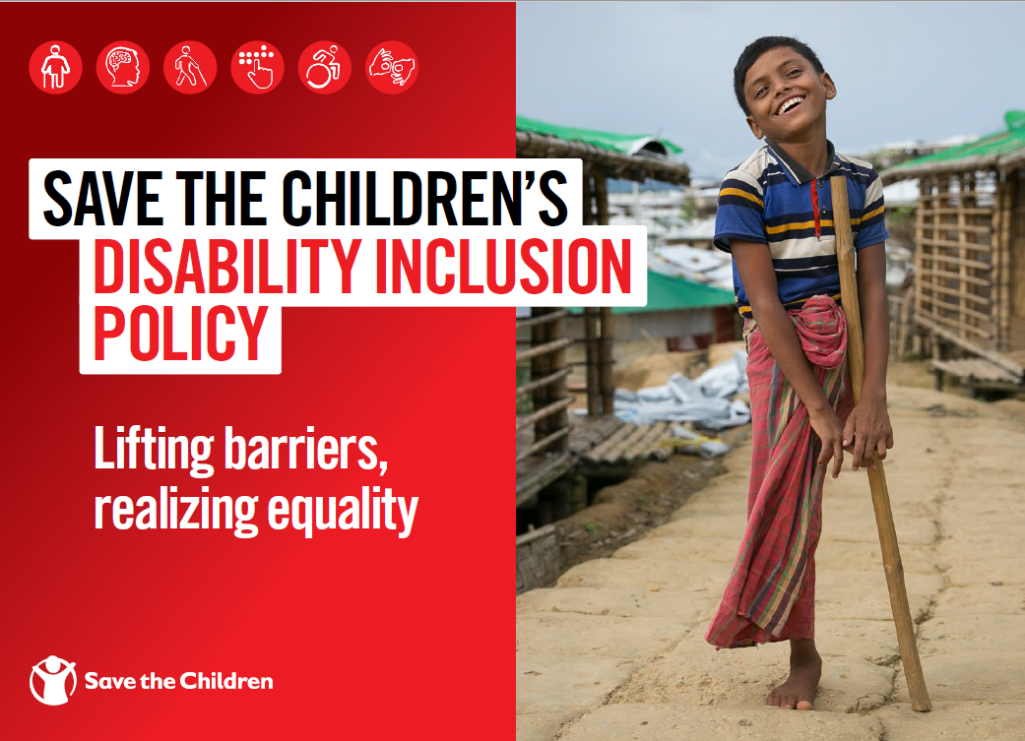
Launched on December 2nd 2021

Slide 8
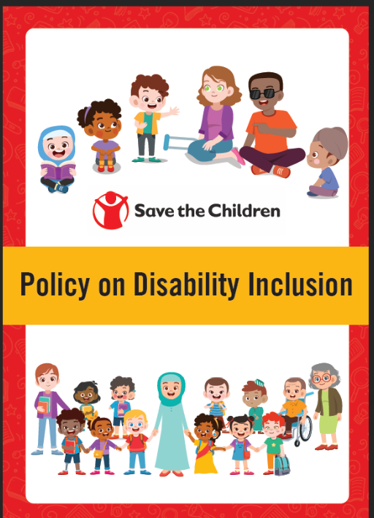
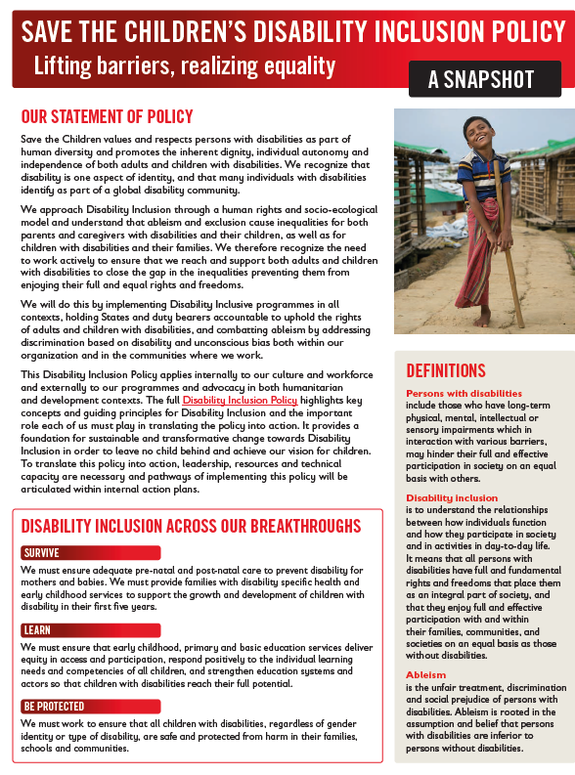
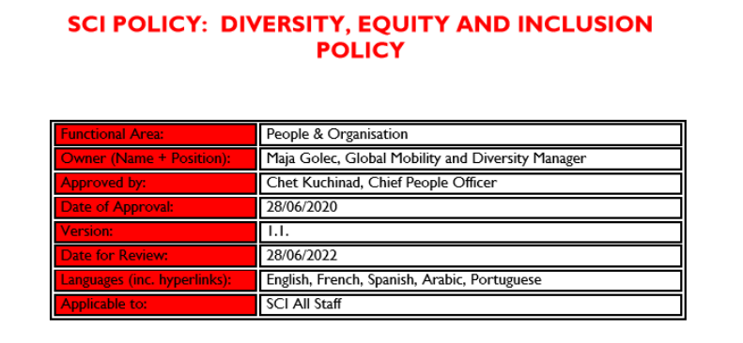
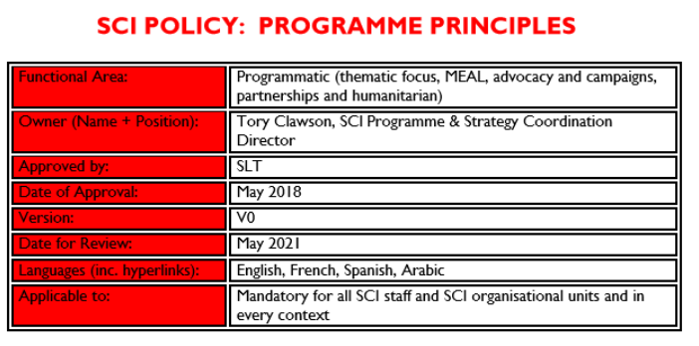
Notes:
Insert child friendly

Slide 9
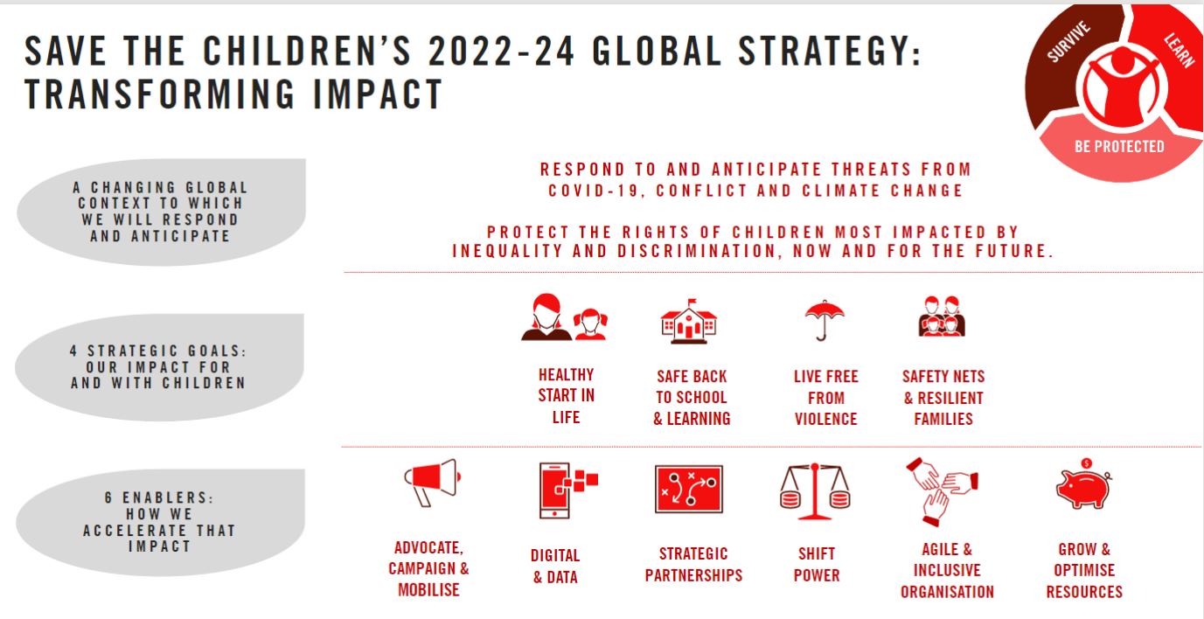
Equitable, accessible and inclusive
16,1% of milestones target children with disabilities (girls 17,4%, extremely poor 16,5%)
50 countries out of 56 target children with disabilities

Slide 10
What we commit to:
Partner with organizations of persons with disabilities (OPDs)
    national, regional , local and grassroot
    different types of disability groups
Partner for advocacy and programming
Support strengthening of OPDs
Support children with disabilities to organize into networks and associations
Our systems to support this commitment
OPD directory
Partnership matrix (beyond OPDs)
Seed funding through initiatives as Watch me Learn! & Disability Inclusion Accelerator
Increased flexibility in compliance and contracting when partnering
Engagement with International Disability Alliance

Slide 11

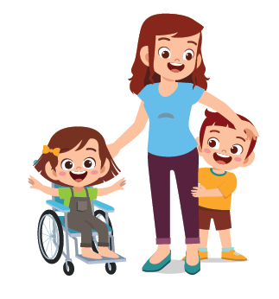
What we commit to:
Plan and design programmes to eliminate root causes, barriers and rights violations
Increase knowledge about the rights of adults and children with disabilities
Identify children with disabilities and prioritize early intervention services
Work with entire families
Notes:
In addition to the notes: say this:
Disability inclusive programming consists of actively removing all barriers which will facilitate a person with disabilities to equally access and fully participate in society and daily activities. We do this both through targeted programmes and by adapting our business as usual.
It is an ACTIVE process; disability inclusion does not happen naturally, it must be planed and DESIGNED for!
Save the Children is accountable to the communities we work with and although we are not striving to be leading experts in disability inclusion, we cannot outsource the work which we want to benefit children and families with disabilities. Our goal is that, whatever we as an organization offer, should also benefit children and families with disabilities, sometimes even more since we have a focus on those children most impact by inequality and discrimination.
What we do as an organization goes far beyond what many disability-focused actors do and we therefore must ensure that we all, as staff in our different roles are confident to work with children and families with disabilities. This is the main focus of the Disability Inclusion Technical working group, to support teams across our organization to better include children with disabilities across all programmes. We pride ourselves with moving beyond standard and regular recommendations and putting considerable effort to make very detailed and technical adaptations to our programmes and services so children with disabilities and children of parents with disabilities can benefit from them.

Slide 12
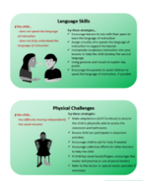
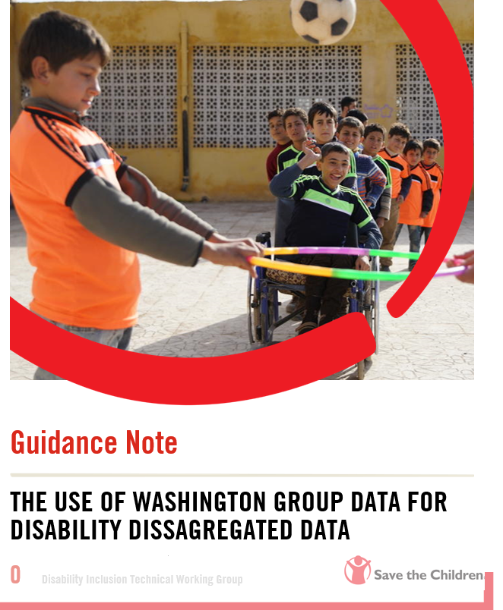
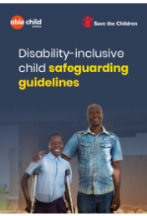
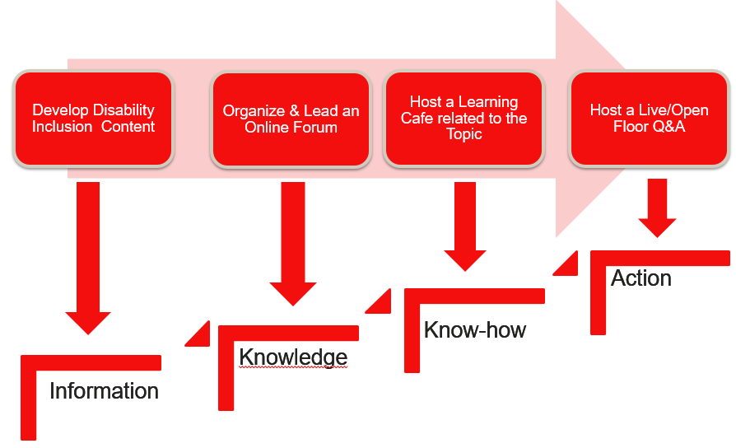
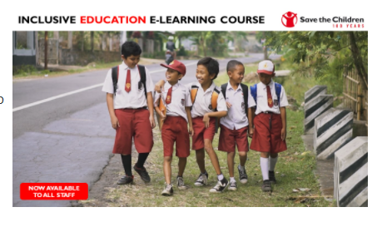
Our systems to support this commitment
Disability Inclusion Programme Guidelines, Data and Accessibility (forthcoming)
Guidelines on Construction
Country office Self-assessment on Disability Inclusion (forthcoming)
Inclusive Education E-learning, Handbook, SNAP and position paper
Inclusive Education Toolkit (forthcoming)
Global partnerships with relevant actors
Technical support through coaching and our Disability Inclusion Competency Development Initiative Learning Series
Disability Inclusive Child Safeguarding Guidelines and Toolkit
Disability Inclusive Common Approach Toolkits and Learning Courses

Slide 13

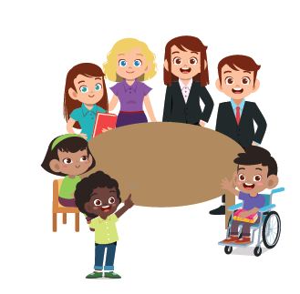

What we commit to:
support duty-bearers to meet their human rights obligations
use empowering images and language that celebrate diversity
support children with disabilities as child rights defenders and to engage in national, regional and international child rights reporting mechanisms
expand the evidence base for inclusive programming across themes, including but not limited to the collection of Disability Disaggregated Data (DDD)
Notes:
Say :
The Disability movement is a very strong movement and we should with our strong advocacy for children’s rights coordinate to both include disability rights into child rights but also lend a child perspective to disability rights.
Advocacy is our tool for speaking and acting with and for children with disabilities on issues that affect them. We must therefore engage children with disabilities on different levels to promote the implementation of the CRC and the CRPD and ensure that legislation is in place and resourced effectively.
At the local level this means to address root causes of ableism, discrimination and inequality at family and community level
Our interventions address inequality and discrimination and give children with disabilities a voice
At national level it means to support children with disabilities to engage government and have a voice in legislative agenda.
Working alongside children and the disability movement to engage governments and other duty bearers
At international level it means working with Children with disabilities and the disability movement on international accountability
supporting children with disabilities and the disability movement to report on UNCRPD , UNCRC etc.
We will work to include a diversity of children with disabilities including children with intellectual disabilities, complex disabilities and invisible disabilities. We can also create new conversations and support new platforms for children with disabilities, OPDs and government and other duty bearers to meet and foster a culture of inclusion.

Slide 14
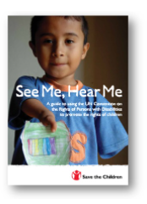
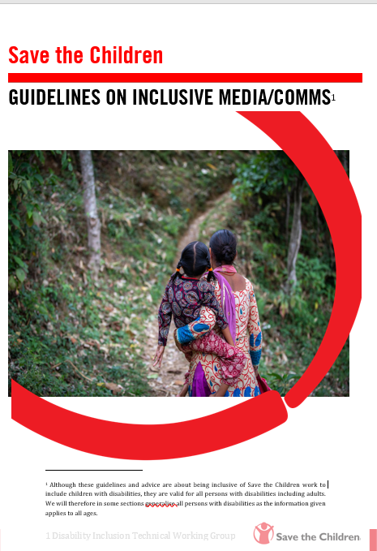
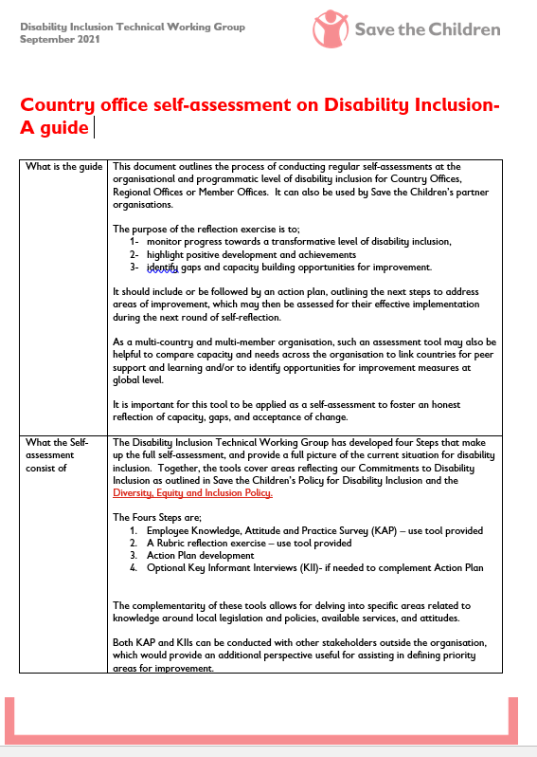
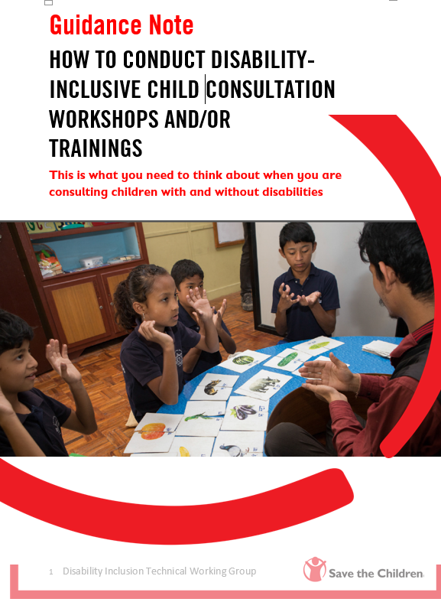
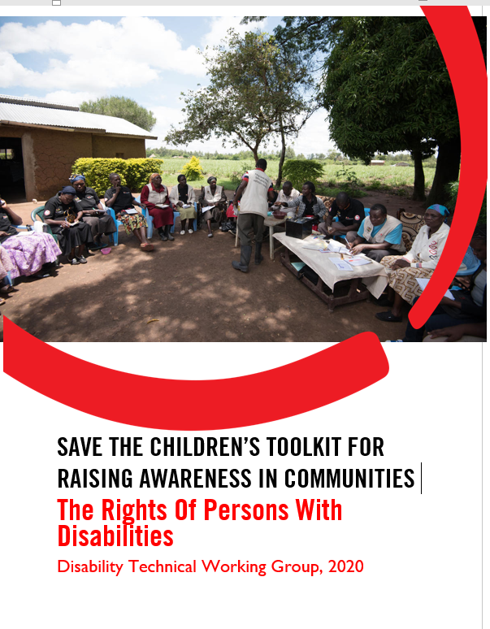
Our systems to support this commitment
Resources on child rights and disability rights and UNCRPD monitoring tools
Training materials on the UNCRPD , See Me, Hear me Guide
Competency Learning Series on Inclusive media/communication and child participation/advocacy
Community Awareness Toolkit
Country office Disability Inclusion Self Assessment
Continuous engagement with International Development and Disability Consortium and International Disability Alliance

Slide 15

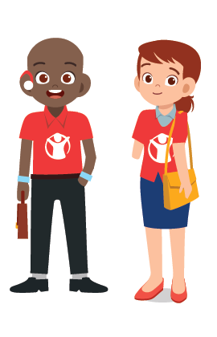
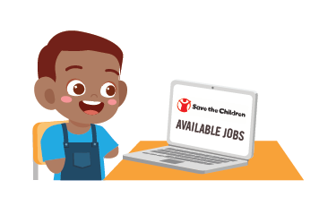
What we commit to:
Develop proactive, intentional system to equitably recruit and retain persons with disabilities
Develop relationships with persons with disabilities and OPDs to widen applicant pool
Create accessible, inclusive and equality-centered working environments
Provide ‘reasonable accommodation’

Slide 16
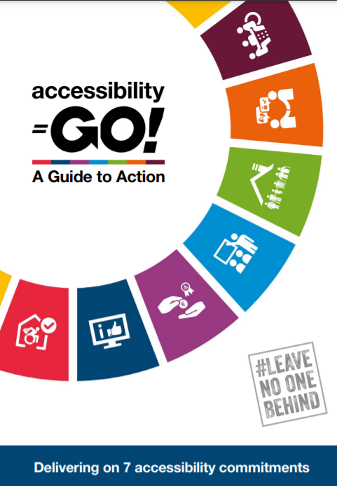
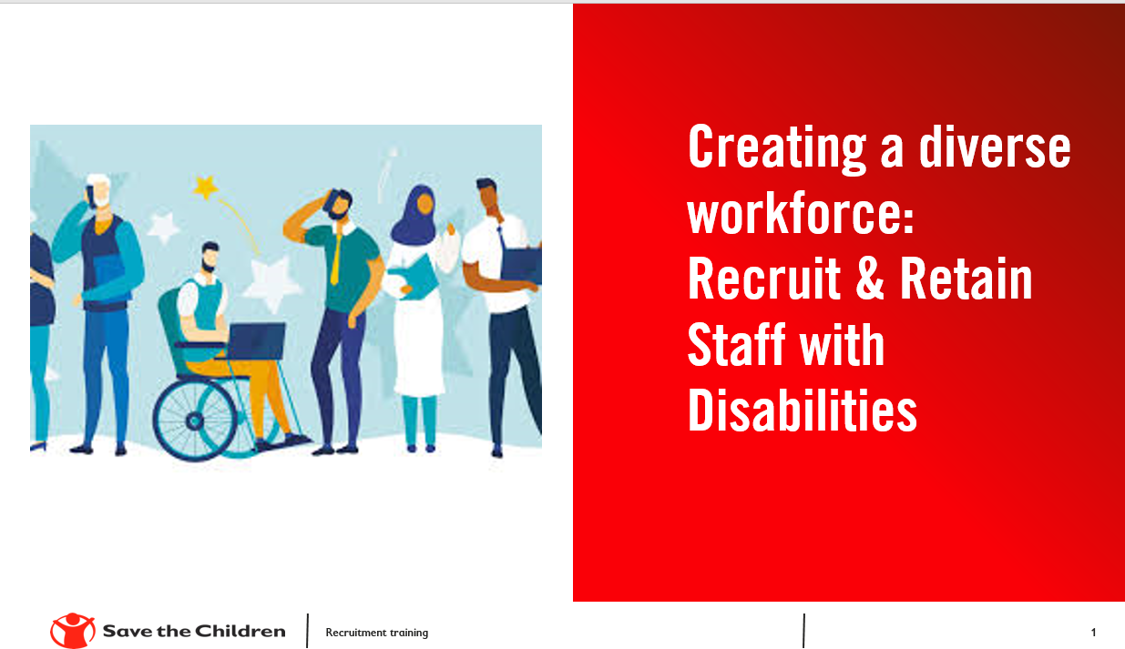
Our systems to support this commitment
Disability Policy and DEI policy
DEI Manager and Disability team focal point
Trainings to recruiting managers
Possible DI HR Schemes
Equity and diversity data
Disability Employee Forum/ group

Slide 17
Where you find more on Disability Inclusion!
Link to Policies
Disabilityinfo@savethechildren.org
Disability Inclusion Resources and webinars
SCI Global Community for Children with Disabilities on Workplace
Disability Inclusion on OneNet
SCI Inclusive Education Community of Practice on Workplace
Inclusive Education on OneNet

Slide 18
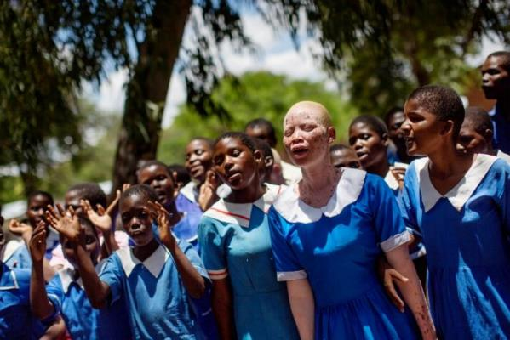
Lets Understand Disability

Slide 19
Did you know?
The number of people in the world living with a disability is…
1 million
56 million
1 billion
2) Disability is more common in low and middle income countries than in high income countries….
True
False
3) The number of people with disabilities is decreasing…
True
False

Slide 20
Children with disabilities compare to Children without disabilities (UNICEF global data, 2021)
24% less likely to receive early stimulation and responsive care
47% more likely to be out of primary school​
34% more likely to be stunted
25% more likely to be wasted
41% more likely to feel discriminated against​
49% more likely to have never attended school​
42% less likely to have foundational reading and numeracy skills
32% more likely to experience severe corporal punishment

Slide 21
Impairments and examples of related functional difficulties
Vision - reading written messages (leaflets, posters etc.), reaching hospitals/health centers alone.
Hearing - listening to audio messages (radio, tv), difficulties to communicate with doctors or health staff.
Speech - difficulties to communicate with doctors or health staff.
Physical – reaching health facilities and using them with freedom and independency due to lack of accessibility in the venue or in transports.

Slide 22
Cognitive difficulties and Intellectual Disabilities - understanding different health messages (leaflets, posters, radio, tv), difficulties to communicate with health staff. In some cases, they do not feel comfortable being with non-familiar people.
Autism spectrum - understanding different messages, difficulties to communicate with health staff. Difficulties to adapt to new routines, sensory sensitivity and difficulties with generally accepted social rules.

Slide 23
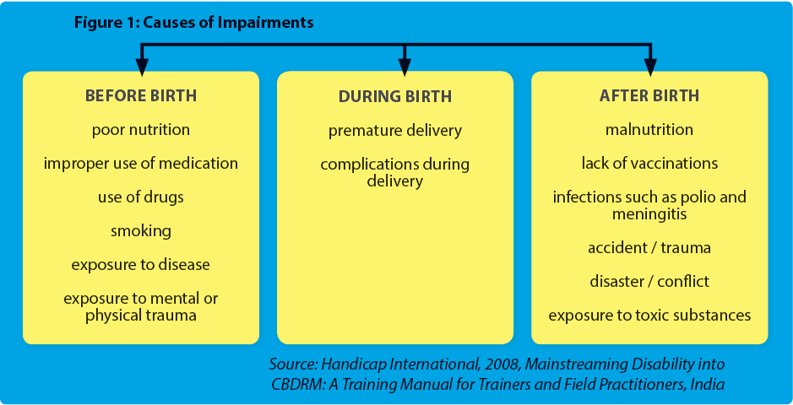
Cause of Impairments:

Slide 24
Ture or False?
Genetic factors can cause impairments
Some impairments can be prevented
Impairments can be cured by surgeries
If there are bad sprits around the house, it will cause impairments

Slide 25
Impairments+ Barriers = Disability (disabling situation)
IMPAIRMENTS = Relate to differences in
SEEING
HEARING,
MOVING
THINKING
BEHAVIOUR
BARRIERS = relate to
Obstacles in the environment that STOP a person achieving their rights
Notes:
Make clear that this convention is unique because it is developed by persons with disabilities i.e. the rights holders. There are also good general comments from the committee
See more on next slide and use whichever slide.

Slide 26
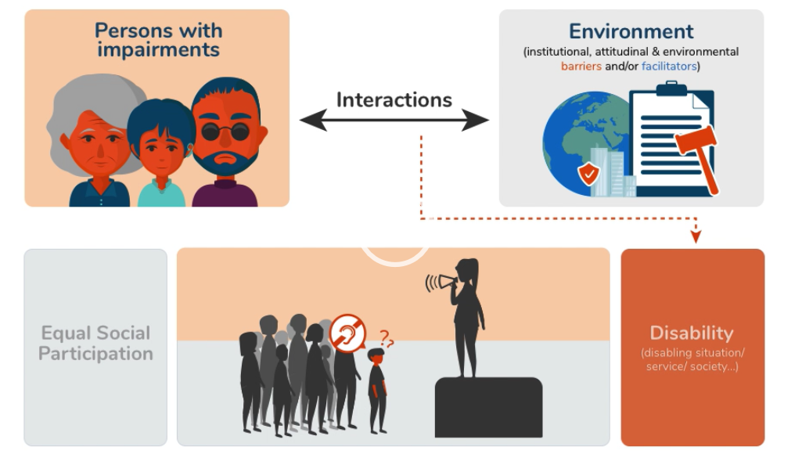
Impairment meets exclusive environment
Notes:
This picture shows that there is a child who is deaf in the meeting, however the leader of the meeting is using a loudspeaker ONLY which means that the child cannot understand what she is saying. Imagine how confusing this would be for a child, they may have been separated from their parents in an emergency situation and they cannot understand what the messages are re: evacuation. In this situation the child has a disability because the COMMUNICATION has been EXCLUSIVE – ie- only suitable for some people.

Slide 27
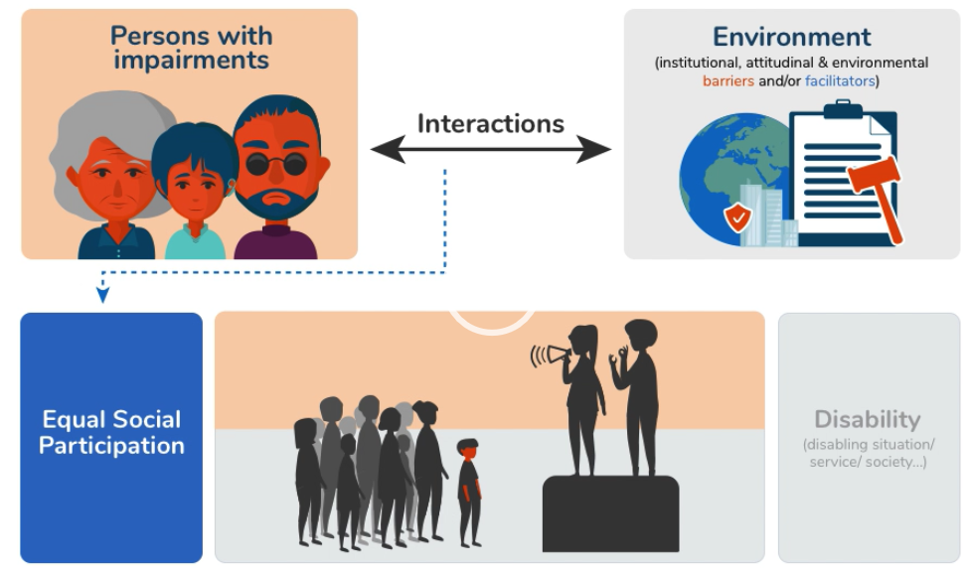
Impairment meets inclusive environment
Notes:
In this picture, you will see that the child is still attending the meeting, the leader is still using the loudspeaker to convey information but she now has a sign language interpreter next to her so that everyone can benefit. The child no longer has a disability and can participate in the evacuation procedure on an equal level with others.

Slide 28
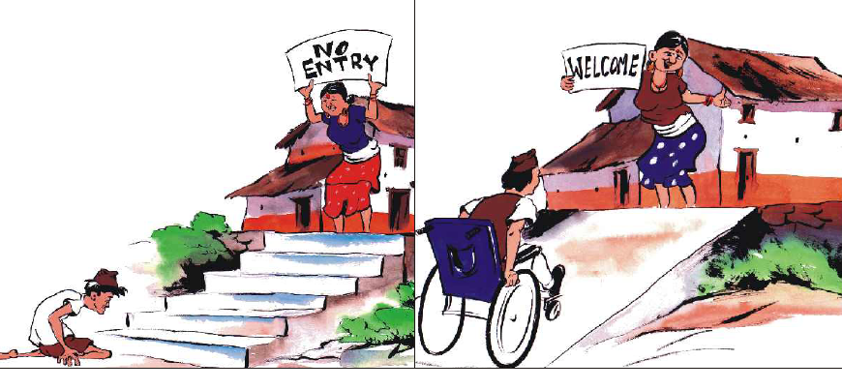
Notes:
Point out the physical barriers (no access to rehabilitation, habilitation, assistive devices, stairs) – vs access to all this and removal by putting in a ramp
The attitudinal barriers (reduced dignity, unwelcoming and discriminatory attitudes, exclusion, being shunned)- vs welcoming
Structural/ Institutional barriers of society and institutions

Slide 29
C. Take a few minutes…
What are some common myths or beliefs about where disabilities comes from in your community/ country?
Notes:
Use a flip chart and let participants call out differnt beliefs, misconceptions and myth, write them down and share reflections.
Is anything comes up that is a myth but many believe try to ask around it and have them share perceptions and then dispel it in a sensitive manner if harmful and explain why it is harmful.
In the end, point out that we are all products of our environments and as staff we need to challenge our own beliefs but also know the beliefs and myths in society and out communities so we can meet them, dispel them and remove attitudinal barriers through our work. If you have personal experience of harmful beliefs (positive or negative) from your field experience do share an example to reinforce your point.

Slide 30

Disability Models - Charity
Words that are used to describe me – tragic, helpless, sad, weak
People think they need to ‘help me’
People think I cannot contribute to society, that I have no value
People see me as dependent and unable to play, learn or work
People see me as needing charity or welfare
People only see my impairment
I am the problem
People think I must be separated from my family
Notes:
Susan McGowan /Martina Orsander – 1 minutes
Charity model
The underlying approach in this model is that the individuals impairment is the problem and they help from the outside. In this slide, you will see what this approach might feel like as a child with a disability from the different text boxes.

Slide 31

Disability Models - Medical
Health workers want to fix or cure me
If I get ‘fixed’ then I can fit into society
Health workers only see me as a patient with medical needs
People think I cant go to a regular school or live with my family
Medical care is seen as the only option to make my life better
People only see my impairment,
I am the problem
I need specialists which are expensive and often not available
Notes:
Susan McGowan /Martina Orsander – 1 minute
Medical Model
The underlying approach in this model is also that the individuals impairment is the problem and they need to be fixed by the health system. For participants joining today who are health professionals, by training you are likely to be familiar with the medical model of disability. You were trained to assess and fix the problem through medicine, surgery or rehabilitation.
In this slide, you will see what this approach might feel like as a child with a disability from the different text boxes.
Note - From medical model came a lot of rehabilitation, habilitation, assistive devices etc but the lack of dignity and equity and rights led persons with disabilities to push for a more social and rights based approach to disability which eventually led to the Convention on the Rights of Persons with Disabilities and our current view on disability.

Slide 32

Disability Models – Social/Rights
Disability is part of human diversity
People with disability belong INSIDE society
People with Disabilities have rights
States are obligated to uphold the rights of People with Disabilities
Barriers in society can be taken away to help me participate fully
It is the barriers in society that interact with my impairment to cause disability
People with disability are agents of change in their own life
Notes:
Susan McGowan /Martina Orsander – 1 minute
The Social Model aligns with our understanding of Disability today, which has been agreed upon and endorsed by Organisations of People with Disability globally – disability is an interaction between an impairment and barriers in society. In this slide, you will get a sense of what this approach might feel like as a person with disability – which is quite a contrast to the two earlier approaches.

Slide 33
Human Rights Based Approach to Development
All people have an equal right to influence and participate in the definition and implementation of development.
  Persons taking part in development are active actors instead of passive receivers of help.
Special emphasis on the rights of vulnerable groups e.g. persons with a disability
Aim is that everyone, including the poorest people know their rights and are able act for them.

Slide 34
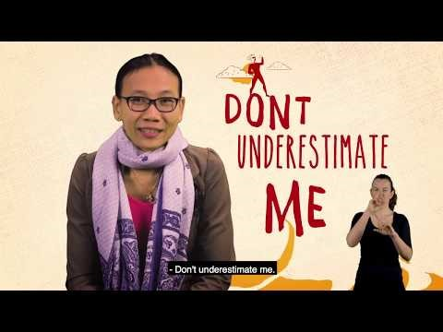
Video CBM
https://youtu.be/BMgwEIQrRPE
Notes:
3 minutes
Our understanding of Disability is evolving from simply a medical or charitable perspective. Lets listen to the perspectives of people with disabilities from around the world that are challenging myths, stereotypes and old ways of thinking about what a person with a disability can or cannot do. This video was produced by CBM for International Day of People with a Disability 2018 in collaboration with people with disabilities from around the world.

Slide 35
Exclusion
Hiding, not registered at birth
Negative attitudes and misconceptions
  Multiple discrimination e.g. women/girls with a disability, HIV/AIDS, indigenous background or belonging to a sexual minority.
Difficult to get assistive devices
No access to sign language
No diagnoses or recognition of some categories of disabilities.
Notes:
Some examples.
Point out that being hidden needs to be worked on and it is often due to ignorance

Slide 36
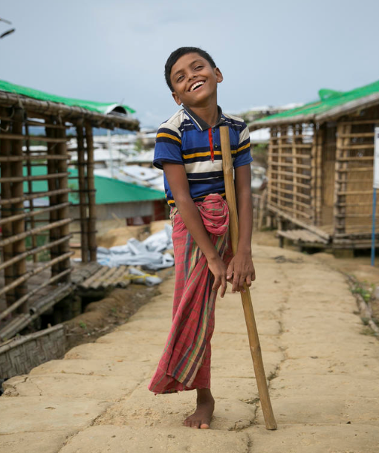

End of Day 1 Morning
Q&A

Slide 37
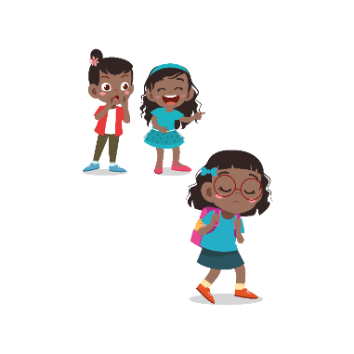
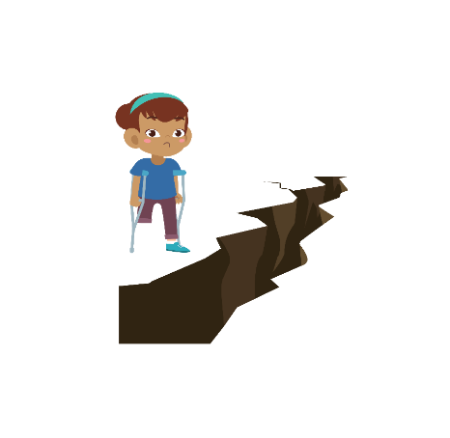
Understanding Barriers

Slide 38

PANEL DISCUSSION

Slide 39
DAY 2
Understanding what exclusion, discrimination and marginalisation looks like
Understanding Disability Rights

Slide 40
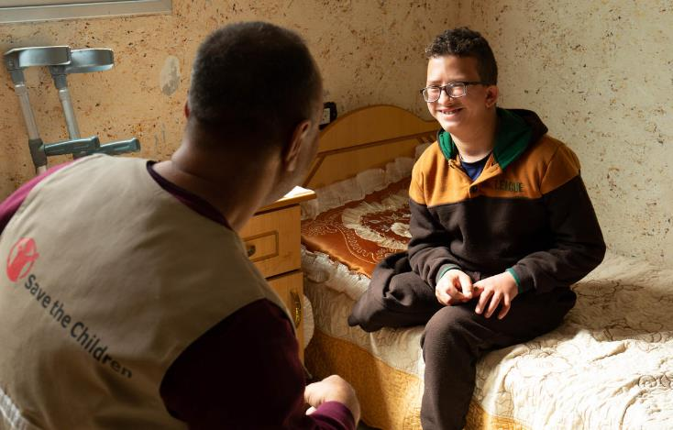
Children with Disabilities and discrimination

Slide 41
Disability and exclusion from participation
Children with disabilities…
are assumed to not understand/have opinions
may not have attended school
may need basic information on human rights, child and disability rights
may need information in different formats/ more time to understand
are often forgotten or excluded
are not invited because they are not the best ’token’ kids
parents with disabilities may not be aware-hence children unaware
disability movement also sometimes forgets child perspective
disability movement lack systems for child safeguarding
Accessibility is not considered even when children with disabilities are invited
Notes:
Here are some examples of exclusion you can list.

Slide 42
Exercise
What signs of exclusion have you seen in your community and why do you think that is?

Slide 43
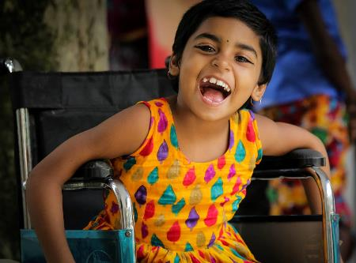
Most essential building blocks for the individual child
Isolation /self pity/ fear/ depression
Counselling/ Acceptance
Understand Rights/ get role models
Self-worth
Participation/ Inclusion
Identification/ Diagnosis
Notes:
In our work we will meet children with disabilities and their families in different phases of they life and especially on different levels when it comes to participating from all between complete isolation to full participation. So let us take a look at this.
Some children as we know are very isolated at home. Parents have a lot of challenges when there is a birth of a child with disabilities because of ignorance, fears, myths they know and attitudes in communities. Many children are discouraged from caring for the child in different ways and can be taunted by the community. Where this happens it is not uncommon to leave children home and keep them indoors. The other aspect of this is when a person without impairment suddenly or over a period of time becomes impaired. This can happen through illness, injury, war etc etc. There often a stage of depression and not much they feel they can do in life etc. Some people think their life is over-
The importance in these cases or any onset of disability is to understand either what it is (diagnosis) or at least that this is some form of impairment but you can still live a good life and there is help to get. Many countries we work in have very few opportunities and services that can provide diagnosis so we need to learn how to work with children regardless of that.
One very important step to self worth is counselling. It is only through counselling and support parents and children themselves become aware that there are others with the same impairment and there is support to get and services to access- Counselling should be done by someone with the same impairment so a representative from a DPO is the best and they often have these services and activities already so better for them than for Save the Children alone to conduct such counselling.
Once counselling happens the individual and family will start to recognize role models who has overcome their personal challenges and now have full and meaningful lives. This is when the person and family can join a DPO and start learning about their rights.
This in turn leads to a self-worth which is a must-have to be able to participate and feel included and actively engage in the community etc.
So in our work we will meet children that can be anywhere on this cycle and depending on where they are we can address the barriers and provide support and services or referral to services.

Slide 44
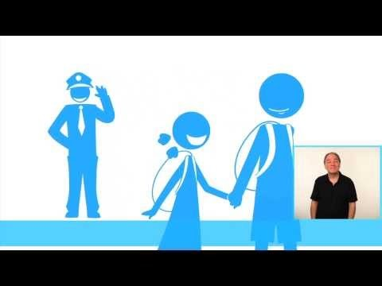
Disability in the life cycle
https://www.youtube.com/watch?v=nGjpod__fpg

Slide 45
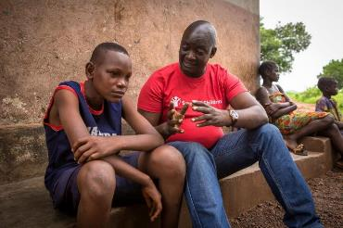
Guiding principles for working with children with disabilities
Non-discrimination (Child Protection Minimum Standards CPMS)
Accessible communication (sign language, non verbal other than sign language)
Avoid derogatory terms
Do not speak over the child
Actively challenge discrimination and prejudice
Seek informed consent
Supported vs substituted decision making
Children with intellectual impairments
Children who are non verbal and not using sign language
Respect confidentiality
The use of interpreters (sign language or other)
The use of carer/support staff/ family member
Notes:
Non-discrimination: Those involved in the case management process must treat each child based on his or her individual needs. Children and families should not be discriminated against based on their gender, age, religion, disability, ethnicity, race, sexual orientation, economic status or other factors. Children should be given a choice in speaking with male or female case workers based on what makes them feel most comfortable and children and families should be able to communicate to the case worker in their own language, including national sign language or in exceptional cases non-verbal communication. Case workers must actively work to avoid judgmental, derogatory or negative language in their work and challenge discrimination and prejudice in policies and practices.
Seek informed consent and/or informed assent (see section 6 : Information Management): Informed consent is the voluntary agreement of a person who exercises free and informed choice. To give informed consent, children and families must fully understand the services and options available, the potential risks and benefits to receiving services, and how information will be collected and used. Children and families also need to understand when and why confidentiality would be broken. Informed assent is the willingnes s to participate in services. It is used when children are too young either by law or biologically to give informed consent, but still old enough to agree to participate. Special consideration should be taken to children with intellectual disabilities and learning difficulties to ensure that the child understands his or her options and that caregivers do not decide on behalf of children. All means of communication should be exhausted to explain the options available before the assumption is made that the child does not have the cognitive ability to understand.
Respect confidentiality: Those involved in the case management process need to ensure children and families’ right to privacy. This includes how information is stored, shared, and released to others. The term “need-to-know” describes limiting information, especially sensitive information, to only those that “need to know” in order to protect the child. Respecting confidentiality requires service providers to protect information gathered about a child and collecting storing and keeping information safely with agreed data protection policies. Case workers should not identify the names of the children or share identifying information about them to anyone who is not directly involved in the case, this includes other case workers. In the case of use of interpreters, sign language interpreters or non-verbal communication experts a confidentiality agreement must be signed with said individual. This is particularly important of the person belongs to the same community as the child. Using caregivers and relatives close to the child as interpreters and communicators comes with certain risks and should at times be avoided depending on the situation of the particular child . There are some limits in confidentiality when it comes to identifying immediate safety concerns for a child or being required by law to report a crime. The limits to confidentiality must be explained to children and families at the beginning of the assessment.
7 in the versions I received
Of the child
Lets discuss this
Lets discuss this
Base all actions on sound knowledge of child development, child rights, and child protection: Case workers and their supervisors must understand vulnerabilities, power dynamics, and risk factors to help meet the underlying and often unspoken needs of children and their families. A strong understanding of child development will help the case workers to better involve and communicate with children based on their age, gender, ability and evolving capacity. Specific training may be needed for working with very young children (aged 0-3) if there are large number of this age group identified in the criteria of the programme. This may also apply to working with children with intellectual disabilities or severe learning difficulties or children who are non-verbal. Save the Children’s programming is based on children’s rights and this understanding is vital to understanding international norms and standards are incorporated. A strong understanding of gendered norms and power relations is also necessary in order to provide gender sensitive case management. Additional training on the specific needs of some children is also required to handle sensitive cases. Please see section 8 on the specific needs of children who have been sexually exploited, are unaccompanied or separated, and/or are on the move. Without specific knowledge of these areas, case plans will not adequately address children’s needs and rights and may cause unintended harm.

Slide 46
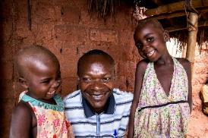
Ensuring an appropriate and context specific approach
“ We can not treat your child here in case she dies at my hands her spirit will haunt me”
Perceptions and beliefs around disability in the community
Identify services and referral pathways (protection and health)
Consult community based rehabilitation (CBR), OPDs and and special schools
Define barriers and enablers; attitudinal, Environmental, communication/ information and Institutional
Understand and assess living/care arrangements and risks
Notes:
How are children currently being protected? What government led, community based structures exist to respond to protection needs of children and which children do or do not access these?
Information for the context analysis can be gained from:
Review of the CRSA, country reports, situation reports/ assessments, multi-sectoral needs assessments, and general or rapid child protection needs assessments including desk reviews that may have already been conducted.
Consultation with key stakeholders, including children, families and communities. Consultations should ensure equitable participation of different groups, such as boys, girls, women and men, including those with disabilities through Disabled Persons’ Organisations (DPOs) (.
Community perceptions of concepts, such as child protection risks, harms, and local/traditional norms and values that support prevalence of certain practices, such as different forms of sexual and gender-based violence, or systematic discrimination of children with disabilities.. .
Information should be collected on physical, structural and attitudinal barriers faced by children with disabilities and their caregivers to accessing services, support and information and their root causes should be identified. Barriers may include:
Discriminatory practices against girls with disabilities in obtaining reproductive health care (e.g., denial of information or services);
Difficulty reaching services due to distance or lack of transport;
Inaccessible facilities (e.g., schools, hospitals or child-friendly spaces with stairs and no ramp, toilets that are not wheelchair-accessible);
Prejudice, fear or excluding attitudes amongst community members, service providers, family members and also case workers;
Lack of knowledge and support from case workers; and
Lack of suitable supplies for children with disabilities (e.g., appropriate-sized wheelchairs, crutches, hearing aids, etc.).
Inaccessible information

Slide 47
Disability Sensitive Language
What words do you have in your language to describe persons with disabilities…
Always put the person first – not their impairment
Avoid negative language and stereotypes
Avoid messages of curing or treating people with disability
Promote the capabilities and contributions of people with disability
Notes:
The way disability is communicated should promote and support the human rights of people with disabilities. This document serves as a quick guide to inclusive communications and language through a lens of the human rights based approach. The approach, enshrined in the Convention of the Rights of Persons with Disabilities (CRPD), recognises that the experience of disability occurs when the way society is organised is unaccommodating to an individual’s needs and this creates barriers that prevent their participation. By reducing or removing these barriers, the experience of disability can be reduced.
For example, it’s not that a child with a vision impairment is incapable of learning, but rather that the school isn’t accessible; it lacks Braille resources, the teachers have negative attitudes, and the government has no education policy for children with disabilities – all of these barriers are what keeps that child from achieving an education, not their impairment. The human rights based approach looks at ways of removing and reducing barriers that prevent people with disabilities from full participation in society.
Resource – CBM Language Guide

Slide 48
Respectful Language
YES | NO
Person with a disability | Disabled Person, Abnormal, Handicapped
Person without a disabilty | Normal person
People with psychosocial disability or Mental Health issues | Mental, Crazy, Insane, disturbed, lunatic,
Person with intellectual disability or learning disability | Slow, mental handicap, mentally ill, retarded,
Person who is blind or person who has a vision impairment | The blind, suffers from vision loss
Deaf person or person who is hard of hearing | Hearing impaired, deaf – mute, suffers from hearing loss
Person with epilepsy | Epileptic
Person with a physical disability | Crippled or lame
Person who uses a wheelchair | Confined or restricted to a wheelchair, wheelchair user, wheelchair bound
Source - CBM Australia: Communications and Language Guide
Notes:
Can you review the words that you used earlier to describe a person with a disability – are there any that you would now disagree with?
Invalid; Invalids or the disabled, person with special needs, the handicapped or disabled persons.
The deaf or hard of hearing or deaf-mutes.
The blind or visually impaired.
Spastic
A paraplegic
An autist or the autistic
Amputee
Person suffering from Downs Syndrome
- Mentally retarded
Developmentally challenged children
Normal schools
- Speech disorders
- Persons with attention disorders or hyperactivity
Persons with autistic spectrum disorders
Persons with motor disorders
- Persons with behavioural problems and emotional disorders
Special schools
Persons with disabilities.
Deaf person, hard of hearing person, or person with hearing impairment.
Blind person or visually impaired person.
Person with cerebral palsy;
Person with paraplegia;
- Person with poliomyelitis;
Person with the consequences of muscle disease;
- Person with severe chronic illnesses;
Person with physical disabilities.
Person with autism; person or children in the autistic spectrum.
Person with physical disabilities, person with an amputated body part, person without a leg or arm, etc.
Person or child with Downs Syndrome
- Person with intellectual difficulties
Children with learning difficulties
- Persons with voice and speech impairments
Persons with impaired attention / hyperactivity
- Persons with autism spectrum
Persons with reduced motor ability
- Persons with behavioural and emotional disabilities
Schools for special education

Slide 49
https://www.youtube.com/watch?v=Gv1aDEFlXq8&t=27s

Slide 50
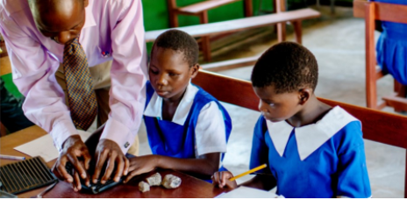
UN Convention on the Rights of Persons with Disabilities (CRPD)

Slide 51
Contents
Contents
1. Understands UNCRPD
2. Key Articles related to Children with Disabilities
3. States Obligatory
4. Monitoring process

Slide 52
UN Convention on the Rights of Persons with Disabilities
It is an international human rights treaty to protect the rights and dignity of persons with disabilities.
It resulted from decades of disability awareness raising and disability movement
Adopted by the UN General Assembly in 2006 and came into force on 3rd May 2008.
As of October 2020, it has 164 signatories and 182 parties
It didn’t create new rights for persons with disabilities, but to ensure the full enjoyment of human rights by persons with disabilities.
UNCRPD is monitored by the Committee of the Rights of Persons with Disabilities.
Notes:
Make clear that this convention is unique because it is developed by persons with disabilities i.e. the rights holders. There are also good general comments from the committee
See more on next slide and use whichever slide.

Slide 53
UNCRPD
It has a Preamble and 50 Articles.
State parties to the Convention are obligatory to promote, protect, and ensure the full enjoyment of human rights of persons with disabilities and ensure that persons with disabilities enjoy full equality under the law.
The UNCRPD marks a ‘paradigm shift’ in attitudes and approaches to persons with disabilities. Persons with disabilities are not viewed as "objects" of charity, medical treatment and social protection; rather as "subjects" with rights, who are capable of claiming those rights and making decisions for their lives based on their free and informed consent as well as being active members of society.

Slide 54
Key Articles (Children with Disabilities)
Article 7: Children with disabilities
Ensure that the best interests of the child is a primary consideration, and to provide disability and age-appropriate assistance to ensure that children with disabilities are able to realize the right to their express views on all matters of concern to them and have them taken seriously in accordance with age and maturity
Article 13 – Access to justice
Age-appropriate measures must be introduced to ensure that children with disabilities have access to justice.
Article 16 – Freedom from exploitation, violence and abuse
Measures must be taken to provide age-sensitive assistance to prevent exploitation, violence and abuse; age-, gender- and disability sensitive protection and rehabilitation services; and child-focused legislation to ensure that exploitation, violence and abuse is identified and investigated.

Slide 55
Continued..
Article 18 – Liberty of movement and nationality:
Measures must be taken to ensure that children with disabilities are registered immediately after birth
Article 23- Respect for Home and the Family
Children with disabilities are entitled to retain their fertility, and therefore forced sterilisation is prohibited. Children with disabilities have equal rights with respect to family life and governments have obligations to provide services and support to families to prevent abandonment, concealment and segregation. In addition, children with disabilities must not be separated from parents unless this is in their best interests and never on the basis of disability. Where parents are unable to care for children, efforts must be made to provide alternative care within the wider family or within the community in a family setting.

Slide 56
Continued..
Article 24: Education
Education at all levels must be inclusive and children with disabilities have an equal entitlement to general education. Inclusive education requires provision of all necessary support and technical aids, including respect for linguistic identity, and facilitating the learning of Braille, orientation and mobility skills, and training of teachers.

Slide 57
Obligation on Governments
Governments are required to adopt broad measures to ensure implementation of the Convention including legislative measure. (Article4)
Statistics and Data Collection (Article 31)
International Cooperation (Article 32)
National Implementation and Monitoring (Article 33): OPDs should be involved in monitoring

Slide 58
International Monitoring Process
Committee on the rights of Persons with Disabilities: 18 independent experts with disabilities form a committee to monitor how countries implement CRPD.
Periodic Reports by Governments: Countries must provide periodic reports ( 2 years the first time, every 4 years later) to the Committee on how they are complying with their Convention obligations
Committee review the report and responds with a List of Issues that raise questions and requests additional information. Government must prove replies.
Shadow Report ( Parallel reports) : OPDs are encouraged to submit shadow reports to the committee in addition to State report
Concluding Observations: issued by the committee to make suggestions and general recommendations.

Slide 59
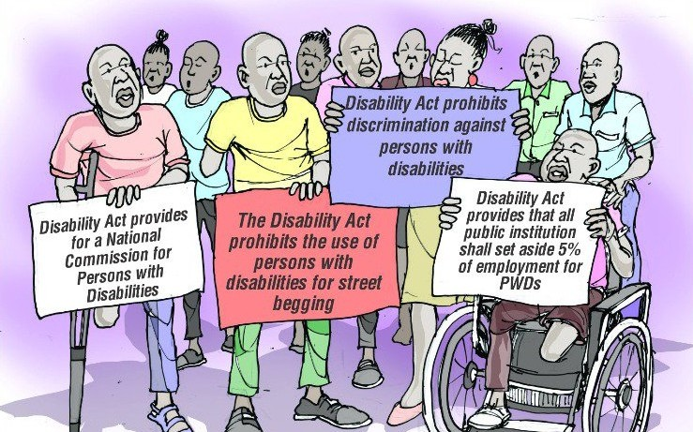

COMMON KNOWLEDGE ON DISABILITY AND DOMESTIC LAWS FOR PWDs IN SL
Abridged version produced by

Slide 60
SAVE THE CHILDREN SIERRA LEONE
INTRODUCON TO DISABILITY
AND
FRINDLY VERSION OF THE PERSONS WITH DISABILITY ACT 2011

Slide 61
CONTENT
Disability structures
Aim, Vision and Mission of SLUDI
Membership and structures of SLUDI
Establishment of the commission
Composition and roles of the commission
Definition of Disability
Prevalence Categories of disability and their derogatory names
Common Myth about disability in Sierra Leone
Rights and Privileges in the PWD Act 2011
Offences and Penalties in the PWD Act 2011
Questions and Answers

Slide 62
DISABILITY STRUCTURES
CIVIL SOCIETY ORGANISATIONS (CSOs)
The federation(Umbrella body or Union) –Sierra Leone Union on Disability Issues (SLUDI)
Organizations of Persons with Disabilities (OPDs) – Including sun umbrella bodies and orgs of different categories and mixed groups operate as CBO, Local NGO,
Registered with the union, Councils, MSW, MoPED, CAC etc based on their interventions and operations,
MINISTRIES DEPARTMENT AGENCIES (MDAs)
Ministry of Social welfare (MSW)
National Commission for Persons with Disabilities (NCPD) and others
International and Local Non-Governmental Organizations (ILNGOs)
Handicap Internation( Humanity and Inclusion)
Sight savers Sierra Leone
Helen Keller International and others like
Save the Children, WFD, World Vision, Marie Stopes SL, Christian Aid, NDI
UNCT - UN Agencies like UNDP, UNFPA, UN Womenn

Slide 63
THE MAIN AIM, VISION AND MISSION OF SLUDI
THE MAIN AIM
The aim of the Union is to generally promote issues and support programmes and activities aimed at raising the status and welfare of disabled persons in Sierra Leone
VISION
The Vision of is “to achieve independence of PWDs, promote the implementation of the 2011 Disability Act and other critical legislations for an inclusive Sierra Leone”
MISSION
The Mission of the Sierra Leone Union on Disability Issues is to “work in partnership, represent, advocate, network, coordinate and monitor issues appertaining to disability”.

Slide 64
SLUDI MEMBERSHIP AND STRUCTURES
MEMBERSHIP
(a) Organizations of Persons with Disabilities (OPDs)
(b) Institutions of and for the disabled persons (LNGOs)
(c) (C) Special Needs Institutions
(d) Honorary members appointed by the Executive
(e) Philanthropist and Patrons who shall be invited by the Union
STRUCTURES
Annual General Meetings and Congress
Advisory Board
National Executive
Regional Coordinators
District Executives
Administrative Body and Ad-hoc Committees
Ex-Officio’s
Heads of OPDs and Disability Stakeholders

Slide 65
In April 2011 the Parliament of Sierra Leone passed a law called ‘The Person with Disability Act 2011’ and this Act has given power to the Ministry of Social Welfrae to establish the Disability Commission. If so, what it is for?
This Commission is a separate body which works purely to protect persons with disabilities against discrimination. When established, it own its offices, recruit staff, receive money from government and other bodies to protect persons with disabilities.

Slide 66
COMPOSITION OF THE COMMISSION
According to this law the Commission will have sixteen (16) members comprising:
1) The Chairman-This person must have a very wide idea about disability issues
2) Eight (8) persons each one representing the following Ministries:
Min of Social Welfare 6. Min of Finance
Min of Youth and sport 7. Min of Health
Min of Education 8. Min of Labour
Min of Transport and Aviation 9. Min of Culture and Tourism
Four reps from SLUDI 10. 2 LNGOs and 2 INGOs

Slide 67

FUNCTIONS OF THE NATIONAL COMMISSION FOR PERSONS WITH DISABILITY
Part 2: Sections 2 - 13
The Act provides for the establishment of a Commission to ensure the well being of persons with disability.
KEY FUNCTIONS
The Commission should work with the Ministry to develop ways for persons with disability to have equal access and opportunities to rehabilitation, community, social recreational, educational, sporting, cultural and employment services
Investigate and issue a report on any discrimination of person with disability
Register and maintain a database of persons with disability, service providers for persons with disability
Provide equipment of assistance to persons with disability
Resource Centre for and provide information to the public on the rights of Persons with Disability

Slide 68
WHAT IS DISABILITY
What is Disability: According to the Persons with Disability Act, 2011 disability is defined as a physical, sensory, mental or other impairment which has a substantial long-term adverse effect on a person’s ability to carry out normal day-to-day activities.
The extent to which a condition hinders a person will vary from individual to individual and the general range of disabilities varies from conditions that are mild (for example, the need to wear reading glasses) to severe (for example brain injury).

Slide 69
CATEGORIES OF DISABILITIES AND ITS DEROGATORY NAMES
Physically disability Eg;
Polio - Cripple , Ggbenkelehky
Amputee - One foot or hand
Kyphosis - Hunch back
Paralysis - Die foot of hand
Stroke -
• Visually impaired (Blind and low Vision) - Boss Eye or Bilnd eye
• Hearing impaired (Deaf and speech Impairment) - Orkorky

Slide 70
CONTINUATION
Mental disability -Ed nor flop
• Intellectual disability - Crase man, foolfool
• Albinism - Juice
• Autism - Yato pikin or man
Leprosy - cut foot or hand
• Little people - Dwarf
Epilepsy - Devil
Deaf Blindness - Not useful porsin
Multiple Disability - half mortal man

Slide 71
EXAMPLES OF COMMON MYTHS
Normally when we want to talk with hearing impaired- we don’t use normal tone- we normally resort to shouting.
Accessibility is normally assumed to limit to physical accessibility, but it could also mean making written accessible- braille, tactile or making audio materials to people with visual or cognitive disabilities.
When talking to someone using wheel chair we tend to bow down and don’t think we can still stand and talk to them. We get hospital beds for all forgetting that disabled mothers require special beds.

Slide 72
COMMON MYTHS (CONT.)
We get public transport forgetting that we need disabled friendly public transport for pwds
We normally think less about making our institutions as inclusive as possible. (Infrastructure and equipment)
We normally carve our work as one size fit all forgetting that there are people with different disabilities.
We mostly assume a PWD needs assistance and we normally do not ask them but want to do it for them

Slide 73
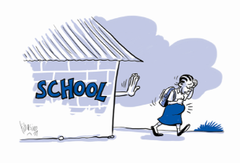
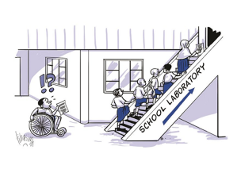
RIGHTS AND PRIVILEGES - Part 4
The Right to Free Education: Section 14 - 16
The Act provides for persons with disability to have a right to free education in tertiary institutions (college and universities) and for every educational institution to provide facilities for learning and an enabling environment for persons with disability.
It is an offence for an educational institution to deny admission to or expel a person because of their disability
The structures of educational institutions should be adapted to make access easier for persons with disability.
Sign language and braille should be introduced in educational institutions and Government scholarships and grants will be available to students who specializes in courses for support to persons with disability

Slide 74
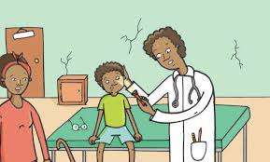
RIGHTS AND PRIVILEGES
The Right to Free Medical Services: Section 17 - 18
The Act provides for persons with disability to be provided with free medical services in public health institutions.
Where a person has been found to have a disability by a doctor, a certificate of disability will be submitted to the medical Board
It is compulsory for any child on medical treatment to be screened for early signs of disability

Slide 75

RIGHTS AND PRIVILEGES
Discrimination in Employment: Section 19 - 21
The Act makes it an offence to deny a person with disability having the right qualifications access to employment opportunities based on the fact that they have a disability
It is also an offence to treat persons with disability differently from other persons in the workplace in the area of the terms and conditions of the job, compensation, privileges, benefits, allowances
If the person with disability acquired the disability while working the employer must retain the employee at the job and in the same position

Slide 76
RIGHTS AND PRIVILEGES
Benefits to Employers of Persons with Disability: Section 23
An employer of a person with disability is entitled to tax deductions from the National Revenue Authority
To claim the tax deductions the employer must show a certificate from the Ministry of Labour that they have in their employment a person with disability who is accredited by the Commission as to their disability, skills and qualification.
An employer who makes structural changes to the workplace in order to accommodate persons with disability is also entitled to tax deductions

Slide 77
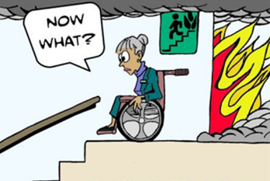
RIGHTS AND PRIVILEGES
Right to barrier free environment: Section 24
Persons with disability are entitled to have access to buildings, roads, and other facilities
Owners of public buildings must adapt them to suit persons with disability
Owners of public service vehicles must adapt them to suit persons with disability
The Act gives the Commission the power to order owners of public premises to make structural adjustment to their premises to suit persons with disability.
HELP!

Slide 78
RIGHTS AND PRIVILEGES
Rights to access to public premises, services and amenities: Section 27-28
A person with disability must not be denied entry into any public premises or be refused services ordinarily given to members of the public as a result of their disability alone.
Persons with disability are entitled to free use of public recreational and sports facilities

Slide 79
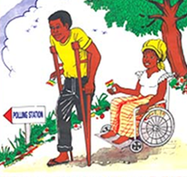
RIGHTS AND PRIVILEGES
The Right to Vote: Section 29
During elections The National Electoral Commission must make sure the polling stations are accessible to persons with disability and that they are provided with all the assistance needed for them to exercise their right to vote

Slide 80
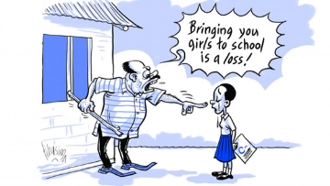
RIGHTS AND PRIVILEGES
Offences and Penalties: Section 35
It is an offence for a parent or guardian to hide a person with disability or to fail to register that person
If found guilty of such an offence the accused person could be fined any amount up to Le2,000,000 or be imprisoned for up to one year or be fined and imprisoned.
You are a curse to me and the world should never know you’re my child

Slide 81
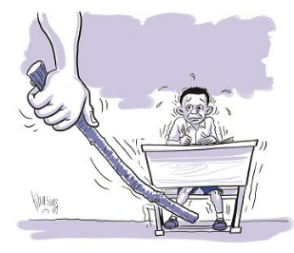
RIGHTS AND PRIVILEGES
Offences and Penalties: Section 36
Under the Act it is a crime to cause another person’s disability whether intentionally or through negligence and if found guilt the accused person can be fined up to Le20,000,000 or be imprisoned for up to 5 years or given both the fine and imprisonment
The convicted person may be asked to compensate the victim to any sum the court thinks appropriate.

Slide 82
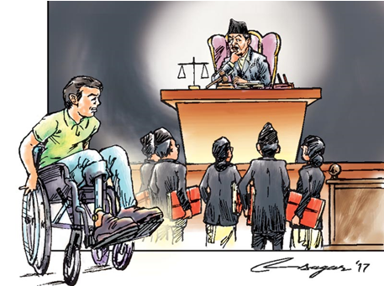

Slide 83
Barriers and enables across thematic areas

Slide 84
HEALTH

Slide 85


Why disability inclusion in health?

Slide 86

Barriers to equitable health for children with disabilities
Neglected, left alone, ignored, without food
Hidden at home due to stigma
Left uninformed/ unaware
Poor health and infections
Forced sterilization
Not be prioritized (family and health providers)
Privacy and confidentiality may be compromised
Health systems not inclusive
Health information inaccessible
No access to transport, facilities or medicine
Untrained HCP, negative attitudes, lack of extra time, care and attention
Blurred lines between impairment and illness
“ We can not treat your child here in case she dies at my hands her spirit will haunt me”
Notes:
Some key aspects to keep in mind:
Stigma that leaves mothers to be abandoned, the fact that communities encourage parents to kill children or institutionalize them (even medical professionals and religious and community leaders give this advice sometimes).
Chained or tied up
Here you need to emphasize that we must not judge family members who do this but try to understand why and provide a better solution. Often it is not done out of malice but practical reasons when the child cannot be looked after or if it has a tendency to harm others or him/herself etc.
Harder to recognize harm
Due to isolation or inability to communicate sometimes children with disabilities do not understand that they are maltreated. Without references to the outside world or ’normal’ treatment they may not perceive their situation as unusual or harmful.
Harder to detect inappropriate touching
For children with disabilities who needs constant assistance with personal care, it can be very hard to understand the difference between appropriate and inappropriate touch. This is because they are used to having other people touching their bodies, including private parts as part of the care and hygiene routine. What for a child who does not require other people to touch them can be seen as a clear case of inappropriate touching may not be the same for a child who requires support that involved touching.

Slide 87
Examples of Care seeking behaviors in Eastern Kenya
- 1 child in 17 had completed all courses of vaccinations.
parents worry more about the child with disability for perceived higher risks of falling sick and suffer complications from the illness.
Constant anxiety and anticipated death of the child imposes a heavy burden on the parent / caregiver. Some impairments more than others
Children with disabilities often fail to present at healthcare facilities and outreach services – once showing up, health had reached more critical state
CHW reported the absence of children with disabilities from vaccination programmes and campaigns.
Health workers not aware of what constitutes an ‘inclusive’ facility nor received training on or coaching´. Not able to identify appropriate interventions beyond simple specialist equipment such as wheelchairs.
- All the parents and some health workers identified the need for ‘more love’ and ‘bigger hearts’ among health care staff at facilities, having observed abusive or stigmatizing attitudes treating these cases
Link
Notes:
HCP health care professionals

Slide 88

Inclusive Health Care
Poorer health
Added health care needs
Inequities and inequalities in access
Not part of decision making
Child health
Sexual & Reproductive Health
WASH
Nutrition
Communicable Disease
Rehabilitation
Assistive Devices
Mental Health
Maternal & Infant Health

Slide 89
What Save the Children CAN do…
Mapping Referral Pathways
Community based rehabilitation, Specialist care, Diagnosis, Surgery, Assistive Devices, Daily living skills
Identification
Developmental milestone screening
Observations of signs (cleft lip, club foot, cerebral palsy, spina bifida, hydrocephalus)
Meet Primary health care need
Dignified accessible and respectful treatment – non-discrimination
Apply inclusive patient care skills (communication, feeding and swallowing strategies)
Disaggregate Patient data
Specialist care- not per default
Referrals (specific paediatric evaluation, rehab services, community based services)
follow up to ensure the child got what they needed.
Information in accessible formats and care seeking behaviours
Early intervention key messages and information about services and vaccinations

Slide 90

Leadership and Participation and equal Partnership
Organisations of Persons with Disabilities (OPDs)
are Key to
► train doctors, nurses and health professionals;
► design of accessible health services;
► advice on accessibility to the created environment;
► advice on communication access and outreach services;
► identification of strategies for inclusion;
► provision of support to families of persons and patients with disabilities
A disability access focal point could be designated within each hospital or health clinic to serve as a resource and to interface with the disability community, with the families of patients with disabilities, and with others.
Directory of examples of organizations of persons with disabilities in countries
Source: Disability Toolkit for Africa Inclusive Health

Slide 91






Rehabilitation- A human right- Art 26
Notes:
Only 5-15% of people with a disability get the assistive devices and technologies they need. This could be something as simple as a pair of glasses, a hearing aid or a wheelchair. When it comes to nutrition, it might include specilasied teats/nipples for babies with cleft lip/palate or adapted cups for children who have difficulty controlling their head , trunk or arms.

Slide 92

Rehabilitation cont.

Slide 93
NUTRITION

Slide 94


Introduction
Video – Malnutrition & Disability Cycle
Access the full “Global Health and Disability” course here:
https://www.lshtm.ac.uk/study/courses/short-courses/free-online-courses/global-health-and-disability
Notes:
Lori Baxter /Cat Kirk – 5 minutes
The London School of Hygiene and Tropical Medicine offers a course in Global health and Disability that is online and free (you can click on the link to access the full course). In this slide, we can look at a short section of the course that is focused on disability and malnutrition to help us understand more about the issues and how they may relate to the work that Save the Children does in LMICs.

Slide 95

Nutrition in Pregnancy
The impact on the developing child
Poor maternal nutrition in pre pregnancy and periconceptional periods appears to be a risk for preterm birth
Preterm birth is a leading cause of mortality, morbidity and disability
Low maternal folate is associated with neural tube defects
Vitamin D and calcium deficiency are linked with disability
Iodine deficiency is linked with cognitive impairment
Iron deficiency is linked with cognitive and behavioural impairments
Notes:
Lori Baxter/Cat Kirk – 2 minutes
Say - A healthy pregnancy is really important for a safe delivery and a healthy child.
The “first 1,000 days” is the period from conception to a child’s second birthday. This is the most rapid period of brain development at any time in a person’s life. Poor maternal nutrition can impair the child’s growth in utero, and can lead to impairments in early childhood.
One of the biggest risk factors for undernutrition and poor development in early childhood, is preterm birth.
References –
https://www.researchgate.net/publication/279861553_Malnutrition_and_disability_Unexplored_opportunities_for_collaboration
https://pubmed.ncbi.nlm.nih.gov/21548777/
https://academic.oup.com/jn/article/144/7/1075/4569765
https://www.ncbi.nlm.nih.gov/pmc/articles/PMC5372884/

Slide 96

Nutrition in Infancy and Childhood
The impact on the child
Newborns who are born too small are at increased
risk of undernutrition and later developmental disability.
Lack of adequate nutrition in early childhood is associated
with poorer cognitive development
Undernutrition contributes to over 3 million deaths of
children under-five years annually
Children with developmental disability are at increased risk for malnutrition
    One in five children treated for complicated severe acute malnutrition (SAM) in Malawi had an underlying disability
    Children with SAM were three times more likely to die if they had an underlying disability
Notes:
Lori Baxter/ Cat Kirk
Say: “The first 1,000 days continues from pregnancy into early childhood.” Vulnerabilities, such as being born premature can increase a child’s risk for poor development and undernutrition in their first years of life. Even children who are born healthy, face risks to their development and have an increased risk of mortality if they are undernourished.“
In addition
DETAILS (Leaving for Reference, but don’t read)
Children who are born preterm or at low birthweight are at high risk of undernutrition and developmental disability. A systematic review (Milder et al., 2015) found that nearly a quarter (21.4%) of preterm/LBW survivors had a developmental disability. Studies from Rwanda and Burundi found that they had rates of wasting that were triple national averages in early childhood (Kirk et al., 2017; van den Boogard, 2017)
The first 1,000 days – which start in pregnancy until the child’s second birthday – are the most rapid period of brain development in life. Having the right combination and quantity of nutrients during this period is essential for brain growth.
Remember the core interventions of nourishing the youngest: early initiative of breastfeeding (within 1 hour of birth), exclusive breastfeeding for up to 6 months and continued breastfeeding until age 24 months. From 6 months, children need additional foods, through the introduction of safe, nutritious complementary foods.
When adequate nutrition is accompanied with stimulation and a loving home environment, children learn and thrive. Children who are under nourished, are more likely to have poor developmental outcomes.
In addition, under nutrition contributes to over 3 million deaths of children under five years every year
A study in Malawi found 18% of admissions had an underlying disability. The risk of death was also nearly three times as high within 1 year of treatment among children who a disability compared to those without a disability. (van den Heuvel et al., 2017)
REFERENCES
Black et al. (2013). Maternal and child undernutrition and overweight in low-income and middle-income countries. Lancet.
Milner KM, Neal EF, Roberts G, Steer AC, Duke T. Long-term neurodevelopmental outcome in high-risk newborns in resource-limited settings: a systematic review of the literature. Paediatr Int Child Health. 2015;35(3):227‐242.
Newer studies, trends of developmental disability are higher in general:
LBW Infants in Burundi at ~2 years (van den Boogaard et al., 2017)
27% impairment; 18% wasted, 59% underweight, 81% stunted
Small newborns (preterm/LBW <2kg) at ~2 years in Rwanda (Kirk et al., 2017)
67.4% abnormal development screen, 78.3% stunted, 8.8% wasted, 38.1% underweight
46.5% of caregivers reported feeding problems in their child

Slide 97
Why do infants and children with a disability have difficulty getting enough nutrition?
Breastfeeding | Complementary Feeding
Difficulty latching | Difficulty chewing
Coordination of suck/swallow | Difficulty swallowing (dysphagia)
Muscle tone (floppy/stiff) | Unable to self-feed appropriately
Aspiration | Aspiration
Cerebral Palsy
Cleft Lip or Palate
Notes:
Lori Baxter/Cat Kirk
Say - One of the links between having a disability and malnutrition is decreased nutrient intake, which can be due to difficulties feeding.
Say – difficulties feeding commonly present themselves during the breastfeeding period through difficulty latching, challenges coordinating the suck and swallow of breastmilk, and poor muscle tone which can make positioning challenging.
Say – during the complementary feeding period, common difficulties may include difficulty chewing, swallowing or being able to achieve age-appropriate feeding milestones such as learning to self-feed or use utensils.
At all ages, a concern with feeding difficulties is that it can lead to aspiration which is food or liquids going into the lungs which can cause a child to choke, lead to pneumonia, and potentially death.
Source: American Speech-Language-Hearing Association (ASHA)
https://www.asha.org/Practice-Portal/Clinical-Topics/Pediatric-Dysphagia/

Slide 98

Nutrition in Adolescence
The impact on pregnancy and delivery for mother and child
Adolescents have increased dietary needs as it is a period of significant growth and maturation
One-third of adolescent girls and women or reproductive age are anaemic
Adolescent pregnancy increases risk of complications, including having preterm or low birth weight infants
Notes:
Lori Baxter/Cat Kirk
Say—”globally, SCI engages in a variety of programming to prevent or delay pregnancies in adolescent girls. This target group is also relevant to today’s discussion on disability & nutrition”
Points:
Adolescents are growing quickly, and require additional nutrient intake.
Risk of anemia is highest among adolescent girls and women of reproductive age.
Poor nutrition in adolescents contributes to the cycle of undernutrition – an undernourished girl > undernourished woman > undernourished children.
Anemic adolescents were significantly at higher risk of delivering low birth weight or preterm babies compared to their older counterparts.
Research has shown a link between adolescent girls and preterm birth
REFERENCES
Marvin-Dowle, K., Kilner, K., Burley, V. J., & Soltani, H. (2018). Impact of adolescent age on maternal and neonatal outcomes in the Born in Bradford cohort. BMJ open, 8(3), e016258. https://doi.org/10.1136/bmjopen-2017-016258
https://www.ncbi.nlm.nih.gov/pmc/articles/PMC5857698/
https://www.omicsonline.org/open-access/low-birth-weight-and-prematurity-in-teenage-mothers-in-rural-areas-of-burkina-faso-2376-127X-1000344.php?aid=93012
Anemic adolescents were significantly at higher risk of delivering low birth weight or preterm babies compared to their older counterparts.
General Adolescent Nutrition: Black et al. (2013). Maternal and child undernutrition and overweight in low-income and middle-income countries. Lancet.
Healthy nutrition behaviours in adolescences, set the stage for good nutrition and reduced non-communicable diseases in adulthood

Slide 99
Health Systems and Developmental Disability
Important link between developmental disability and poor quality of health services:
  Limited ANC or low quality (iron/folic acid supplementation, treatment of infections, etc.)
  Poor quality intrapartum care can lead to brain injury
  Sub-optimal care for small and sick newborns
  Appropriate identification and treatment of infections (ear infections, malaria)
Poor quality of care
Preventable mortality
Preventable morbidity
Notes:
Lori Baxter/Cat Kirk
Say – Poor quality of health care is a leading cause of preventable deaths, and also preventable morbidity and disability. There are several ways that poor quality of health services contributes to disability:
Low quality ANC may lead to lack of adequate iron/folic acid supplementation in pregnancy and poor identification and treatment of maternal infections. Both of these can lead to small size at birth and developmental disability.
Poor quality of care at the time of birth can lead to brain injury due to lack of oxygen
Low quality care for small and sick newborns can contribute to brain injury (i.e., uncontrolled seizures, severe jaundice, etc.)
Poor health care in childhood (delayed treatment, incorrect treatment), such as poorly treated malaria or ear infections can lead to impairments
REFERENCES
Kruk et al (2018). High Quality Health Systems Report.

Slide 100
CHILD PROTECTION

Slide 101
Enhanced child protection risks for children with disabilities
Mothers abandoned at birth
Children are killed, abandoned or institutionalized
Reduced sentences for murder ‘mercy killings’
‘unreliable’ witnesses = denied access to justice
Beaten and punished
Neglected, left alone, ignored, without food
Chained or tied up
Sexually abused (harder to ward off and warn)
Exploited or forced to work/serve
Over protected
Left uninformed/ unaware
Poor health and infections
Forced sterilization
Particular vulnerabilities
Harder for child to be aware of maltreatment
Harder for child to identify inappropriate touch
Girls are more vulnerable
Intellectual, deaf, blind & deafblind added risk
Disability does NOT equal protection issue
Notes:
Some key aspects to keep in mind:
Here you can talk about the stigma that leaves mothers to be abandonesd, the fact that communities encourgae parents to kill children or institutionalise them (even medical profressionals and religious and community leaders give this advice sometimes).
Chained or tied up
Here you need to emphasize that we must not judge family members who do this but try to understand why and provide a better solution. Often it is not done out of malice but practical reasons when the child cannot be looked after or if it has a tendency to harm others or him/herself etc.
Harder to recognize harm
Due to isolation or inability to communicate sometimes children with disabilities do not understand that they are maltreated. Without references to the outside world or ’normal’ treatment they may not perceive their situation as unusual or harmful.
Harder to detect inappropriate touching
For children with disabilities who needs constant assistance with personal care, it can be very hard to understand the difference between appropriate and inappropriate touch. This is because they are used to having other people touching their bodies, including private parts as part of the care and hygiene routine. What for a child who does not require other people to touch them can be seen as a clear case of inappropriate touching may not be the same for a child who requires support that involved touching.

Slide 102

What Save the Children can do – ex Case Management
Impairment focused:
Refer rehabilitation related needs to relevant service (including community level)
Provide training for every day living skills
Provide assistive devices (canes, prosthetics, spectacles, tricycles, wheelchairs) when needed
Inform and refer to medical and surgical services where needed
Disability/barrier focused:
Support child and family to understand and accept disability
Work with service providers and community to not discriminate/ exclude
Work to remove physical barriers to services/ facilities/ access points
Notes:
The purpose of this slide is to explain why Save the Children and we as staff need to understand the difference in definition between impairment and disability as described in the beginning of the training. It is because we as an organization mainly work with children with disabilities in the sense that we ensure to remove barriers to our programs and in the lives of children with disabilities so they also can survive, learn and be protected. So here are some examples of how we can work with impairment specific things and disability specific things.
Optional Exercise. List actions and divide into impairment or disability focused
Relates to case planning and (referral) case management process.
Use examples. Deaf child-

Slide 103
Considering appropriate services
Example of services
Community based rehabilitation
Speech and language therapists
Sign language trainings
Physiotherapists
Audiologists
Opticians
Doctors, diagnostics
Assistive devises
Autism centers
Day care centers
Vocational trainings
Peer groups
Parent support groups
Sign / Tactile sign interpreters
Barriers to access and using services
Services don’t exist
Most children do not get services
Parents and case workers are unaware of services
Private and very costly services
Services in big cities only
Long waiting lists
Services are run on charity/ fees - no consistency in quality
Country/ community lacks professionals and therapists
Services must be holistic, inclusive and integrated!!
Examples of holistic community based services for children with disabilities in Eastern Europe
https://savethechildren.facebook.com/groups/MACFregionalproject/
Notes:
When [VC1] conducting the mapping of services and identifying safe, child friendly and child sensitive, and ethical referral pathways, identify specific services and supports that are working to ensure safeguarding standards for children with disabilities. These could for example be Disable Persons’ Organisations (DPOs), Community Based Rehabilitation Services, specialised clinics, mobile services, providers for assistive devices etc. When these services and supports are not available, Save the Children and partners should advocate for accessible, inclusive, non-discriminatory, appropriate and safe services.

Slide 104

Meaningful participation and adapted communication
Conditioned dependency
Low expectations of ability leads to learned helplessness where care givers speak and act on behalf of the child leading to the misconception that the child is not able to even if not true
Engaging with children with disabilities:
Accessible and conducive location
Observe interaction between child and family
Address the child directly (not look at the adult, sibling assistant or interpreter)
Adapt the mode of communication
Don’t be uncomfortable (pauses, fear)
Avoid communication by proxy (family member)
Form your own opinion!
South African sign language phrases
Notes:
Keep in mind adapted communication for children with disabilities who needs it, this could be for example sign language or tactile sign language for children who are deaf or deafblind which would require trained interpreters, visual aids or easy language for children with intellectual impairments or learning difficulties. Children on the autism spectrum may need more time, clear instructions and frequent breaks during the assessment.
Braille - relief form of script for the blind, involving combinations of six indentations in special paper which represent letters and numbers.
Orthopaedic or other aids/assistive devices - aids and assistive devices to help persons with disabilities achieve equality of opportunity in participation in all aspects of life and society.
Orthopaedic aids/assistive devices - aids or assistive devices tailored for individuals with physical disabilities, including mechanical or motorised wheelchairs, canes, walking frames, prosthetics, orthopaedic shoes, etc….
. Hearing aids and assistive devices - aids designed for individuals who are deaf or hard of hearing individuals, including analogue and digital hearing aids, inserts and implants, light alarms for crying children, light or vibrating alarms, etc….
Assistive devices and technology for the visually impaired - aids designed for the individuals who are blind or visually impaired, including canes, watches and alarm clocks, speaking thermometers, sound recorders and players, Braille writing devices, and note recording devices for the blind persons, etc….
Healthcare workers and professionals - people with secondary or tertiary education in disciplines related to healthcare and medicine and who are directly employed in providing healthcare to the public, with mandatory respect for the moral and ethical principles of the healthcare professions. This includes doctors working as consultants or still in training in all the different specialisations, nursing staff, medical technicians, psychologists, dentists….
Sign language - a natural human language based on visual cues and hand gestures used by the deaf and hard of hearing communities.

Slide 105
EDUCATION

Slide 106


What this looks like in education
Source: Sue Stubbs/Ingrid Lewis (2008) Inclusive Education – Where there are few resources
Notes:
We need to be recognizing when we (or others) are starting to think of the child as the problem, and shift thinking towards the education system being the problem.

Slide 107
Barriers in education
Children with disabilities are:
Less likely to enroll in school
Less likely to complete school
More likely to be left out of education sector plans
Less likely to have a teacher trained to support their learning needs
Notes:
The graph here shows the distribution of scores on a typical literacy assessment, showing that after a year of Literacy Boost programming, some students were thriving (identifying nearly all of the most used words correctly), while a large portion of children were still unable to identify any of the most used words correctly. This is indicative that the children who need the most support in the classroom are not being reached effectively by their teachers.

Slide 108
Benefits of inclusive education
Quality inclusive education can lead to stronger learning outcomes for both children with disabilities AND children without disabilities
Enhances social inclusion
Provides children the opportunity to go to school in their community
Contributes to the “spirit of understanding, peace, tolerance, equality, and friendship” (a component of the right to education)

Slide 109
Example of disability inclusion: Literacy Boost
Teacher Training
Community Action
Reading Assessment
Reading Materials
Are teachers trained to expect and support diverse learning needs in their classroom (i.e. SNAP)?
Do reading camps and parent training proactively work with OPDs to seek out and include children with disabilities and their families?
Do book banks include diverse materials in terms of content (i.e. about different types of children) and format (i.e. large print, tactile, etc.)?
Do reading assessments account for children with disabilities and disaggregate data to identify learning inequities?
Notes:
These are only some of the examples of how disability inclusion can be addressed in each of the four components of Literacy Boost

Slide 110
Example of disability inclusion: SNAP
Teachers
Golden Rules
Parents
Parent Awareness Raising Sessions
Publishers
Inclusive Materials Development Guidance
External Challenge Cards
Individual Challenge Cards
Individual Education Plan
Notes:
There are separate Save the Children training resources on the Student Needs Action Pack (SNAP), which is designed to help schools and communities more effectively support all children, including children with disabilities. This slide shows the main tools included in SNAP.
Tools for teachers focus on building teacher skills to make accommodations and adaptations in their classrooms.
Parent training focuses on helping parents be stronger advocates for their children:
Inform their child’s teacher about his/her strengths and challenges
Follow up on and support the IEP process
Volunteer in school
Check in with the teacher
Support their child to develop confidence
Encourage their child to ask for help when needed
Support their child’s learning at home
Tools for publishers focus on how to make reading materials more inclusive, in terms of both content and format.

Slide 111
Remember!
Children with disabilities are a very diverse group – there is no single adaptation that will ensure that all children with disabilities are included
Instead, we must build programs that are accessible, and flexible to meet different needs of different beneficiaries
Physical: movement and/or appearance
Spinal cord injury- paraplegia, quadriplegia
Loss of limb
Dwarfism
Sensory: feeling and sensation
Blindness
Low vision
Deafness
Hearing loss
Intellectual: IQ under 70
Difficulty understanding
Difficulty communicating
Self-Care
Neurological: nervous system, speech, muscles, memory, and learning
Epilepsy
Autism Spectrum
Dyslexia
In
Notes:
Important to note here that Dyslexia and other learning difficulties are under the neurological, not intellectual category. Children who have learning disabilities often have average or above average IQ.

Slide 112

HUMANITARIAN

Slide 113

Disability & Risk
People with disabilities and their families are likely to experience greater exposure to shocks/stresses/hazards and increased vulnerability to deal with it.
Notes:
1 minutes
Despite UN Conventions, and National Laws, Policies and Programs, as well as calls to greater accessibility in the SDGs, Sendai Framework, the new Urban Agenda etc the reality is that people with disabilities are disproportionately vulnerable to hazards and less likely to be able to cope when a shock or stress occurs. Lets explore why…..

Slide 114

Fact 1:
People with Disability are less likely to be PREPARED for shocks and stresses
Not in schools= No school safety programs
Not in economic position of ‘choice’ = no collected food, no alternative accommodation, no varied crop
Not included in Community Risk Assessments = needs not considered
Notes:
5 minutes
People with Disability are less prepared for shocks and stresses because:
Children with disabilities do not attend school – estimates suggest only 10% of children with disabilities are in school - which means they do not get access to School Safety Programs
People with disabilities are not included in community risk assessments which means that their needs and priorities are not given consideration
3) Less likely to be in an economic position that would enable ‘choice’ during a crisis, for example, collecting a store of food provisions or moving to alternative accommodation or choosing to plan a different type of crop.
Example: UN Flagship Report on Disability and Development 2018 Reporting to Committee on the Rights of the Persons with Disabilities
Among the 49 States that submitted a national report to the CRPD and reported on CRPD Article 11, eleven States have only generic emergency planning and no specific emergency plans for persons with disabilities.
A global survey conducted in 2013 in 137 countries showed that
- 72% of persons with disabilities surveyed had no personal preparedness plan for disasters;
- 31% of persons with disabilities always have someone to help them evacuate but 13% did not had anyone to assist them.
-Only 21% answered that they could evacuate immediately without difficulty in the event of a sudden disaster; while 73% would face certain difficulty and 6% would not be able to evacuate at all.
- If given sufficient time, the percentage of those who could evacuate with no difficulty increased from 21 % to 38%.
- In addition, only 17% of respondents were aware of a disaster management plan in their community.
-As few as 14% persons with disabilities said they had been consulted on disaster management plan in their community, although half of respondents expressed a wish to participate in community disaster management.
file:///C:/Users/susan.mcgowan/Downloads/409_UN-flagshipreport-disability-1.pdf

Slide 115

Fact 2:
People with disability are less resilient WHEN a shock or stress occurs
More likely to live in poverty= limited evacuation options (transport)
Less likely to see, hear, interpret early warning signals
Less likely to be able to escape quickly and/ or without support from others
Less likely to be able to manage unpredictable circumstances (psycho-social, or care dependent)
Japan Earthquake 2011- twice the death rate of people with disabilities
Notes:
5 minutes
People with disabilities are more vulnerable to shocks and stresses because:
1) Less likely to be able to see, hear or interpret early warning signals e.g. an alarm to signal a fire in a garment factory
2) Less likely to be able to escape quickly and/or without support from others e.g. a person with a mobility impairment would need assistance to escape from a quickly rising flood
3) More likely to be living in poverty and therefore have limited options for evacuation e.g. lack of suitable transport for an elderly person who is bedbound and in pain.
4) Less likely to be able to manage in an unpredictable circumstances, particularly people with psycho-social disabilities or those that are dependent on personal care assistance from family members.
Examples: Japan Earthquake & Tsunami 2011
Japan Earthquake during the 2011 Japan earthquake and tsunami, the death rate among persons with disabilities was twice the death rate of the rest of the population.
Reference - United Nations. Panel discussion on Disaster resilience and disability: Ensuring equality and inclusion, 2013.
Economic and Social Commission for Asia and the Pacific, “Overview of natural disasters and their impacts in Asia and the Pacific 1970-2014”, technical paper

Slide 116

Fact 3
Shocks and stresses increase impairments
Increased injury following cyclones, floods and earthquakes = spinal cord injury, amputation, brain injury
infectious diseases such as Malaria and Tuberculosis = long term cognitive and physical impairments
Breakdown in healthcare
= no medicines, assistive devices and provision of assessment and rehabilitation
Increase in mental health conditions associated with loss and trauma
Water borne diseases = learning difficulties associated with chronic diarrhea and malnutrition
Notes:
3 minutes
Shocks and Stresses can result in death, for example, since 2000 almost 35,000 children around the world died in schools due to disasters – but what is often not counted are the vast numbers of people who acquire impairments which lead to permanent disabilty. With 1 in 3 students aged 13- 15 around the world experiencing bullying, what are the mental health and potential physical impacts of this long term?
Shocks and Stresses increase the number of impairments because:
Increased injuries following cyclones, floods and earthquakes e.g. spinal cord injury, amputation, brain injury;
Increased water borne diseases which can lead to long term disability e.g. learning difficulties associated with chronic diarrhoea and malnutrition
Increased infectious diseases such as Malaria and Tuberculosis which can lead to long term cognitive and physical impairments e.g. such as malaria or Tuberculosis
Breakdown in healthcare which impacts on availability of essential medicines, assistive devices and provision of assessment and rehabilitation
Increase in mental health conditions associated with loss and trauma.
Example- experiences of people with a Disability in Vanuatu during and after tropical cyclone Pam.
People with disabilities were 2.45 x more likely to be injured
Disability specific services were the least available increasing the disadvantage for people with disability
Reference - https://mspgh.unimelb.edu.au/__data/assets/pdf_file/0011/2567576/WEB-DIDRR-Report-14112017.pdf

Slide 117

Fact 4:
People with disability experience MORE disadvantage AFTER a shock or stress occurs
Accessibility often not considered
Specialist equipment or medicines may have been lost, or not using them makes life more difficult.
People with disabilities do not participate in the post disaster needs assessments
more vulnerable to exploitation, violence, physical, sexual and emotional abuse when social fabric breaks down.
Notes:
2 minutes
People with disabilities experience more disadvantage after a shock or stress occurs because
Accessibility during a disaster is often not considered e.g. evacuation centre not accessible or food lines not suitable for a person with a disability to stand for long periods of time or information isn’t presented in a way that is easy to understand.
People with disabilities do not participate in the post disaster needs assessments
People with disabilities often need specialist equipment or medicines that may have been lost during the event – or they may never have had them and the changed circumstance now makes day to day living very difficult.
People with disabilities, particularly women, children and older persons with disabilities, are also more vulnerable to exploitation, violence, physical, sexual and emotional abuse when social fabric breaks down.

Slide 118


Elevated risk in humanitarian contexts
Mothers or caregivers dead or missing
More likely than peers without disabilities to experience psychological distress due to separation from caregivers, breakdown of routine or high risk of abuse (UNICEF, 2013).
Incidents of violence are exacerbated during humanitarian crises
Girls and boys with intellectual and psychosocial disabilities are more vulnerable to sexual violence in humanitarian contexts, due to a lack of: information about gender-based violence; awareness of personal safety; and weaker or no protective peer networks (WRC, 2015).
Notes:
Protection-related risks and impacts
Persons with disabilities may experience targeted violence and abuse because of their disability.166 In a recent survey of persons with disabilities in humanitarian contexts, 27 per cent of respondents reported that they had experienced physical, psychological or other forms of abuse, including forms of sexual abuse.167 Targeted violence against persons with disabilities may include physical attacks, killings,168 denial of food and medicine, harassment, emotional abuse, profound neglect, shackling, and confinement. These abuses are often perpetrated by persons known to them.169 Frequently, targeted violence against persons with disabilities is not reported or monitored, and few programmes identify or respond to such violations.
Persons with disabilities are more likely to experience violations if they are in institutions. Numerous reports have documented severe violations in institutions of the rights of adults and children with disabilities, particularly persons with psychosocial disabilities.170 The violations in question include inhuman and degrading treatment, unsanitary conditions, neglect, verbal, sexual and physical abuse, involuntary medication, and restraint.171
Persons with disabilities are more likely than others to lack personal documents (birth certificate, marriage certificate, travel documents). This may happen for a number of reasons, including failure to register their birth, or denial of their legal capacity (a form of discrimination).
Persons with disabilities who are unable to tell their story may also be at higher risk. This problem arises particularly for persons with intellectual or psychosocial disabilities and persons who have difficulty communicating. During security screening processes, for example, persons with disabilities may not be able to respond accurately to security-related questions.
MAINSTREAMED: Protection programmes are designed and adapted to ensure that they are inclusive of and accessible to everyone, including persons with disabilities. For example, they ensure access to protection programmes, and train protection staff on disability.
TARGETED: Protection programmes accommodate the individual needs of persons with disabilities by providing reasonable accommodations. For example, extension programmes reach out to persons with disabilities who are isolated or distant and support their participation in decisions that are relevant to them.

Slide 119
Risks of exclusion from relief efforts
Structural/Institutional barriers
Response teams ‘forget about them’
Disability movement is not included in emergency preparedness/ response planning
Attitudinal barriers
Caregivers/children with disabilities are assumed to not understand/have opinions
Stigma in community is still there in a crisis
Relief staff avoid persons with disabilities
Enviromental and Communication barriers
Information may not be accessible and missed by caregivers/children with disabilities
May not attend temporary learning spaces /Child friendly spaces
Shelters are often not able to accommodate children with disabilities
No sign language interpreters
No provision of mobility aids, assistive devices or rehabilitation
Notes:
Environmental barriers: • Inaccessible protection services due to distance and inaccessible infrastructure and roads networks • Inaccessible reporting procedures (e.g. for GBV and PSEA) • Lack of outreach or accessible information regarding protection of rights, access to justice and reparations
Attitudinal barriers: • Negative attitudes and stigma against persons with disabilities and their rights • Lack of awareness about legal capacity of persons with disabilities to participate in decision-making and provide informed consent
Institutional barriers: • Limited technical and financial capacity to promote inclusion of persons with disabilities and protection of their rights • Justice mechanisms are not accessible to persons with disabilities • Inaccessible registration systems resulting in denial of legal status for persons with disabilities • Lack of accurate data on persons with disabilities

Slide 120
Extract from account of UNICEF staff in Zimbabwe
On the night the cyclone (Idai) hit, a grandmother realised that her two-roomed house was quickly flooding with water and sand. She grabbed three of her grandchildren and sought refuge at a local church.
The fourth child, who is deaf, was left behind. When asked why she had not taken the child with her, she said that she thought it was more important to save the lives of her three “able-bodied" grandchildren.
She believed the deafness affecting her fourth grandchild was caused by an avenging spirit from her paternal family, which gave his life less value.

Slide 121
MEAL

Slide 122

Planning, Monitoring, Evaluation, Accountability and Learning for Disability Inclusive Programming
An Overview
Sept 2020
Martina Orsander

Slide 123
Why we need inclusive PMEAL
To design programmes that address and remove the barriers to participation and services experienced by persons with disabilities
To know the extent of how our programmes actually benefit adults and children with disabilities
To know how many adults and children with disabilities that benefit from our programmes and advocacy work
To understand what works for adults and children with disabilities
To share good practice on what works for adults and children with disabilities
To allow adults and children with disabilities to share their views on our work
To know how inclusive we are as an organization

Slide 124

Disability Inclusion on organizational level
Internal Disability Inclusion Assessment
Why?
To assess where we are in regards to inclusive programmes and inclusive workplace culture
How?
Disability Inclusion Self-Assessment Tool
Disability Inclusion check list
Disability Inclusion Action Plan
External Accreditation programme

Slide 125
Disability Inclusion on programme and advocacy level
Planning
Why?
- to design appropriate programmes
To ensure children and adults with disabilties benefit from our programmes
To ensure children and adults with disabilties are part of our advocacy work
To ensure children and adults withd disabilties are part of the solutions
To ensure our programmes address and remove barriers to participation and access to services
How?
Disability Situation Analysis tool
Barrier and Enablers Analysis tool
Accessibility Audit tools
Policy review tool

Slide 126
Disability Inclusion on programme and advocacy level
Monitoring
Why?
- To measure the number of adults and children with disabilities in our programmes
To measure progress on disability inclusion through indicators
To revise proggrammes and activities throughout a programme as and when necessary
To be able to present data and examples of how our programs include adults and children with disabilities
How?
Inclusive Indicators Menu (per CAs and thematic areas)
Disability Disaggregated Data using Washington Group Question Sets (4 sets)
Early Identification and Screening Tools
Developmental Milestone Screening Checklists
Targeted data collection tools design

Slide 127
Disability Inclusion on programme and advocacy level
Accountability
Why?
To receive feedback from the adults and children with disabilities in our programmes and the communities we work
To share information with the adults and children with disabilities in our programmes and the communities we work
To address barriers to participation and services within our programmes experiences by children and adults with disabilities
How?
Inclusive Feedback , Response and Reporting Mechanisms
Inclusive consultations with communities
Including adults and children with disabilities in information meetings and make sure we feedback to the communities we work

Slide 128
Disability Inclusion on programme and advocacy level
Learning
Why?
To have lessons learnt, good practice and Do’s and Don’ts
Facilitate peer learning between teams, sectors and countries
To have an organized library with documented case studies and good practices
To showcase our work on disability inclusion and share with partners and external stakeholders and networks/ consortia's including the disability movement
To strengthen future proposals and fundraising efforts
How?
Lessons learnt templates
Case study templates
CoP sharing in webinars and on Workplace
Knowledge management and uploading to Sharepoint, thematic library and the resource Centre.
Participate in external stakeholder meetings and share our experiences

Slide 129
Slide to explain enablers.
Enablers are actions, supports and services that can remove barriers faced by people with disabilities and facilitate them to have equal participation.
Barriers
Tents and temporary shelters have steps and narrow entrances
Trained and qualified service providers are not available
Enablers
Design and procurement guidelines foresee temporary shelters that are accessible
Programmes train staff in principles of inclusion and practical ways to promote it

Slide 130
GROUP WORK 1 hour including break
Each group should for their thematic area:
Identify Barriers to Inclusive Education e.g. Attitudes, Environmental, Communication, Policy/Rules
Identify stakeholders relating to the thematic area
Identify enablers to how to remove the barriers for the thematic area.
All groups will be asked to present back.

Slide 131
Presentation back from each group 1 hour total

Slide 132

Save the Children’s approach to Disability
Inclusive Programming

Slide 133
Our four principles for disability inclusive programming?
1. Build Awareness & Competencies
3. Remove Barriers & Make activities accessible
2. Participation & Leadership by people with disabilities
4. Twin Track Approach
Notes:
Save the Children’s approach to strengthen our work with disability is a rights-based approach with four key building blocks.
Rights based means that all our work relating to disability is compliant with the Convention on the Rights of Persons with disabilities. To guide this we have also developed minimum standards which are soon being endorsed and then we will have guidelines for these as well.
1. Building block number one is to build awareness and competencies within our organisation and across staff teams. It means sensitization, awareness, knowledge, competencies and then action. We want all staff to feel confident enough to not dismiss children and families with disabilities and if they are not sure what to do they know how to find out. We need to recognize that disability is an area of expertise with complex and technical layers as is gender and other thematic areas. But we also recognize that it is mainly about how we treat each other as human beings and as such there is always something we can all do without expertise.
Lets begin with looking at the first principle - Build Awareness of the situation that people with disabilities face in your community. Awareness of the barriers and forming strategies to remove them is considered an essential component of disability-inclusive programs.
This is important because:
Disability has been hidden and often poorly understood in the context of international development.
People with a disability have lacked a voice at many levels of society and attempts to identify and meet their needs have rarely occurred.
There is limited accurate data available of the prevalence of disability which means that decision makers do not have the information they need to plan effectively.
Examples of key awareness messages that you adapt to your specific country context and thematic area:
One billion people, or 15% of the population, live with a disability worldwide.
One in five of the worlds poorest people have a disability
There is a cycle of disability and poverty where disability is both a cause and consequence of poverty
Without addressing disability, we cannot achieve the SDGs
Action on disability is fundamentally about the equalisation of human rights, as expressed in the CRPD.
The long-term economic advantages of including people with a disability far outweigh the initial, often one-off, costs of inclusion.
Disability is a cross-cutting development issue. As well as including specific initiatives to support inclusion, disability needs to be mainstreamed across policy and practice in all development programs.
Including people with a disability ensures the most marginalised are reached and is therefore good development practice.
2. Make activities accessible is about ensuring that all our activities can be used and utilized by all people. Here we need to work with removing barriers, physical, attitudinal and structural and make sure that we budget and design activities in a way that everyone can participate.
3. Participation
Participation and leadership by people with disabilities, this means that we need to respects the Convention and the principle of ’Nothing About us Without us’. Participation is fundamentally about people with a disability participating in decisions that relate to them so that actions affecting people with a disability are not planned or performed without their input. This guiding principle highlights the need for people with a disability to be brought into the process in such a way that they can directly influence decisions. This results in improved inclusion of people with a disability and also brings with it lasting change. Extensive involvement of people with a disability will build skills and capacity. At the same time, people with and without disabilities working alongside each other can often foster changes in attitudes and understanding about abilities, contributions and aspirations of people with a disability.
4. Partnerships with people with a disability can and should occur when there is genuine participation. This also includes partnering with families, wider support networks, service providers and community leaders, where appropriate. Working in partnership with DPOs is a very effective strategy. People with a disability are often empowered and enabled by the confidence and skills that result from the fostering of genuine partnerships.
The disability movement is a very strong movement and it means that persons with disabilities, who themselves were the driving force in getting the convention are the number one experts on the lives and experiences of disability. We as an organization need to recognize this and be humble and ensure that when we do situation analysis, design programmes, implementation and conduct MEAL etc we do so in collaboration with the disability movement but not only with them as beneficiaries we consult but as equal partners and expert leaders for this perspective.

Slide 134



Principle 1 - Build Awareness
Notes:
Lets begin with looking at the first principle - Build Awareness of the situation that people with disabilities face in your community. Awareness of the barriers and forming strategies to remove them is considered an essential component of disability-inclusive programs.
This is important because:
Disability has been hidden and often poorly understood in the context of international development.
People with a disability have lacked a voice at many levels of society and attempts to identify and meet their needs have rarely occurred.
There is limited accurate data available of the prevalence of disability which means that decision makers do not have the information they need to plan effectively.
Examples of key awareness messages that you adapt to your specific country context and thematic area:
One billion people, or 15% of the population, live with a disability worldwide.
One in five of the worlds poorest people have a disability
There is a cycle of disability and poverty where disability is both a cause and consequence of poverty
Without addressing disability, we cannot achieve the SDGs
Action on disability is fundamentally about the equalisation of human rights, as expressed in the CRPD.
The long-term economic advantages of including people with a disability far outweigh the initial, often one-off, costs of inclusion.
Disability is a cross-cutting development issue. As well as including specific initiatives to support inclusion, disability needs to be mainstreamed across policy and practice in all development programs.
Including people with a disability ensures the most marginalised are reached and is therefore good development practice.

Slide 135

Staffing and capacity building
Principle 1 - Build Awareness
Explore and challenge own attitudes and prejudices towards disability and ‘other bodies’
Sensitize and train response team in
disability/ impairments
  inclusive response planning
accessibility and adapted communication,
different vulnerabilities
Inclusive data collection and disaggregated data (link)
Invite a deaf association and learn about sign language
Recruit competent persons with disabilities to the response team
Learn about risks in temporary shelters, care homes
Partnerships
DPOs
CBM, HI, ADD, Light for the world
Sign language interpretation services
Rehab centres
Notes:
Where possible and appropriate, recruit competent persons with disabilities to the team as this, especially if the persons are also involved in the disability movement, will enhance the workforce’s capability on disability inclusion, accessibility and non-discrimination. Social workers with their own disabilities can be a valuable asset to the case management process
Invite the deaf association and learn about sign language to hear about the importance of sign language interpretation or how to communicate with deaf children who do not yet know sign language
As living with a disability comes with specific vulnerabilities depending on the local norms and culture as well as the type of impairment in said community. As these vulnerabilities can be hard to identify for abled-bodied people it is always adviced to invite a Disabled Persons’ Organisations (DPO) when defining vulnerability criteria and assessing vulnerability.
Case workers should be trained in specific child-friendly, disability-friendly and gender-sensitive techniques, especially in working with very young children or children with sensory, intellectual or mental impairments(see Section 8). For children with disabilities the case worker should be observant to look for signs of conditioned dependency. Signs could include the caregiver interrupting to answer on behalf of the child as they have never expected the child to express its own opinions or allowed enough time for the child to do so. The child may in turn never have learnt to communicate independently of their caregiver as they have been conditioned to maintain a state of helplessness or just not been expected to communicate independent thoughts or opinions even if able to do so.

Slide 136
:
Principle 2
Participation & Leadership by people with disabilities
Democracy = freedom of civil society?
Space of civil society getting smaller in many countries
Disability organisations can often still work freely
  - can play an important role in advocating for disability rights
  - E.g. UN Convention on the Rights of Persons with Disabilities
Duty Bearers
Civil Society
Rights holders
Organisations of Persons with Disabilities (OPDs )
Notes:
Participation- link to field visit in two days .
Participation is fundamentally about people with a disability participating in decisions that relate to them so that actions affecting people with a disability are not planned or performed without their input. This guiding principle highlights the need for people with a disability to be brought into the process in such a way that they can directly influence decisions. This results in improved inclusion of people with a disability and also brings with it lasting change. Extensive involvement of people with a disability will build skills and capacity. At the same time, people with and without disabilities working alongside each other can often foster changes in attitudes and understanding about abilities, contributions and aspirations of people with a disability.
Partnerships with people with a disability can and should occur when there is genuine participation. This also includes partnering with families, wider support networks, service providers and community leaders, where appropriate. Working in partnership with DPOs is a very effective strategy. People with a disability are often empowered and enabled by the confidence and skills that result from the fostering of genuine partnerships.

Slide 137

Principle 3 Making activities accessible
DISCRIMINATORY POLICIES AND RULES
NEGATIVE ATTITUDES
INACCESSIBLE ENVIRONMENTS
FEW OPTIONS FOR RECEIVING INFORMATION
FEW OPTIONS FOR COMMUNICATION
Notes:
The tern ‘Accessibility’ refers to the suitability of the built environment, the social environment, communication and laws/rules for a wide variety of users. It is based on the premise of equal opportunity and promoting/protecting rights.
Creating a barrier free environment for everyone is very important to disability-inclusive development because a society accessible for persons with disabilities is one accessible to all. This is where the concept of Universal Design is helpful to understand. Universal Design involves designing products and environments so that they can be used by the widest range of people possible without need for adaptation or specialised design. Universal Design evolved from Accessible Design, a design process that addresses the needs of people with disabilities. Universal Design goes further by recognising that there is a wide spectrum of human abilities. Everyone passes through childhood, periods of temporary illness, injury and old age. By designing for this human diversity, we can create things that will be easier for all people to use
The most common BARRIERS to look out for are:
Discriminatory Policies or Rules, e.g. lack of inclusive education policies which mean that children with disabilities are not in mainstream school and are segregated to special schools where they don’t get access to climate change awareness programs, nutrition programs etc.
Physical Inaccessibility for example, slum communities are hard for people with disabilities to navigate independently because they are crowded, have narrow and uneven pathways, low lighting and often very stimulating for the senses.
Poor Information – For example, people with disabilities need the same access to information about urban risk management however if the behavioural change messages are not in a format that they can understand the trainings that are scheduled will not be accessible for them.
Poor communication – for example, to be prepared for disasters, people with disabilities need to be included in risk assessments, but if the training facilitator doesn’t try to communicate in a way that meets the different communication needs of participants, then it isn’t worthwhile that person being there.

Slide 138
Principle 3 Making activities accessible
Solving problems
Notes:
The Star in the Box
Participants are asked to tell if they are given this golden star to have it inserted in the box what they would do?? Things like modifying it, cutting the horns, folding it, enlarging the box, removing the cover and make it wide open are shared.

Slide 139
Principle 3 Making activities accessible
Change People with Disabilities
Rehabilitation
Change Society
Inclusion
Notes:
The start can never be changed means a person with an impairment cannot be modified or fixed but instead remove barriers in the society and even creates room for other characters

Slide 140
Principle 3 Making activities accessible
The Basics – key terms
Accessibility | Universal Design | Reasonable Accommodation
appropriate measures to ensure access, on an equal basis with others, to the physical environment, transportation, information and communications, including information and communications technologies and systems, and to other facilities and services open or provided to the public Example: Sign language interpreter available in all mainstream schools | The design of products, environments, programmes and services to be usable by all people, to the greatest extent possible, without the need for adaptation or specialized design. “Universal design” shall not exclude assistive devices for particular groups of persons with disabilities where this is needed. Example: WASH facilities in refugee camps are made with handrails and ramps | necessary and appropriate modification and adjustments, where needed in a particular case, to ensure to persons with disabilities the enjoyment or exercise on an equal basis with others of all human rights and fundamental freedoms; Example: access to transport to enable a person with a disability to lead a DRR consultation.

Slide 141










Rwanda visit

Slide 142






Barrier Free & Inclusive Society for All!!
Principle 3 Making activities accessible

Slide 143


Universal Design
Principle 3 Making activities accessible

Slide 144




Change Society!
Principle 3 Making activities accessible

Slide 145


Listen to Users’ Voices
Principle 3 Making activities accessible

Slide 146

Video

Slide 147
Key Term 3 - Reasonable Accommodation
Principle 3 Making activities accessible
Screen reader purchased for a staff
Adapted bench or seat for a child
Scribe for a child
Seating a child nearer the front
Printing something in advance to a specific person
Adjusting food item for specific dietary need
Having a preparatory meeting for someone who requests it
Providing someone with a buddy to carry books and help out

Slide 148
Principle 4 - Twin track Approach
Track One
“Mainstream”
Actively include people with disabilities in ALL programs, policies and actions
Example
Advocate for disability inclusive school policies
Promote positive community attitudes
Provide information on sustainable livelihoods in at least 2 formats
Track Two
“Targeted”
Support specific activities to empower and strengthen the capacity of people with disabilities
Example
Teach people with disabilities skills in leadership to support their engagement in Disaster Management Committees
=
Equal rights for people with disabilities
Notes:
Twin track approach
The twin track approach addresses disability across all areas of international development. It promotes concurrent action across two broad sets of initiatives. One set is through disability-specific activities that are targeted directly for people with a disability; the other is through the mainstreaming of disability into broader activities. Interventions on either track alone will not provide the breadth of involvement, integration and support needed for people with a disability to fully participate. It is important to recognise that one organisation does not need to be responsible for both components of the twin track approach; however, it is useful to understand twin track and be aware of relevant referral points to support the success of a disability-inclusive development initiative. This combination of targeted disability-specific components as well as mainstreaming disability into all strategic areas of development ensures authentic participation and involvement by people with a disability in the whole initiative. Genuine inclusion and empowerment can only occur when both tracks are employed together, as the following diagram illustrates.

Slide 149

Principle 4 - Twin track Approach
Quiz – is this IEC resource an example of mainstream activity or a targeted activity for people with disabilty
Notes:
Example – School Setting – Mainstream Activity – Information is presented in LARGE PRINT, PICTURES and SIMPLE WORDs which will support people who are deaf and people with learning difficulties. Working with parents of children with Disabilities as well as Disabled Persons Organisations and Disabilty Service Providers will help you in making sure that your materials are accessible.
Resource
https://resourcecentre.savethechildren.se/sites/default/files/documents/7119.pdf

Slide 150

Principle 4 - Twin track Approach
Quiz – is this WASH facility an example of mainstream activity or a targeted activity for people with disabilty.
What about the wheelchair?
Notes:
Example – School Setting – Mainstream Activity – Information is presented in LARGE PRINT, PICTURES and SIMPLE WORDs which will support people who are deaf and people with learning difficulties. Working with parents of children with Disabilities as well as Disabled Persons Organisations and Disabilty Service Providers will help you in making sure that your materials are accessible.
Resource
https://resourcecentre.savethechildren.se/sites/default/files/documents/7119.pdf

Slide 151

Principle 4 - Twin track Approach
Quiz – is this evacuation drill an example of mainstream activity or a targeted activity for people with disabilty?
Notes:
Example – School Setting – Mainstream Activity – Information is presented in LARGE PRINT, PICTURES and SIMPLE WORDs which will support people who are deaf and people with learning difficulties. Working with parents of children with Disabilities as well as Disabled Persons Organisations and Disabilty Service Providers will help you in making sure that your materials are accessible.
Resource
https://resourcecentre.savethechildren.se/sites/default/files/documents/7119.pdf

Slide 152

Principle 4 - Twin track Approach
Quiz – This is a 10 week program specifically for children with disabilities to raise their knowledge of their rights and build self esteem and coping mechanisms.
Is this an example of mainstream activity or a targeted activity for people with disabilty?
Notes:
Example – School Setting – Mainstream Activity – Information is presented in LARGE PRINT, PICTURES and SIMPLE WORDs which will support people who are deaf and people with learning difficulties. Working with parents of children with Disabilities as well as Disabled Persons Organisations and Disabilty Service Providers will help you in making sure that your materials are accessible.
Resource
https://resourcecentre.savethechildren.se/sites/default/files/documents/7119.pdf

Slide 153
Programme quality standards and core concepts (forthcoming guideline)
Awareness & Capacity
Partnership & Participation
Planning & Design & Budget
MEAL & Data Disaggregation
Identification
Accessible communications, activities and buildings
Advocacy & Communications
Inclusive Work Force
Notes:
Basic Level – Use the ‘Disability Sensitive’ Minimum Standards as a guide – this has evolved from the Gender Equality language which ranks interventions on a scale. As we progress, I would expect that another set of standards can be developed that look at transformative change. Note – This has been developed by SCA for internal use.
Staff Training - Awareness of Disability and by people with disability; Project Cycle and DI and Data Collection
Disability Situation Analysis – UNICEF Guidelines OR CBM Guidelines
Logframe Activities Mainstream Disability
Logframe Activities include targeted activities
Budget has a line for ‘reasonable accommodation’ – demonstrates a commitment to inclusion and can go towards activities that ‘enable’ inclusion and haven’t already been budgeted for.
Participation – children with disabilities, parents of children with disabilities, adults with disabilities; Look for opportunities for leadership e.g. lead child protection committees
Referral Networks – DPOs; Disability Service Providers
Identification actively go out and find people with disability – how – use existing data sets; talk to service providers, schools, health posts, disabled persons organisations, community leaders, other NGOs, UNICEF, WHO; most likely, you will need to use the snowball method;
Data Collection Tools – WGSS and UNICEF Questions
Universal Design Principles

Slide 154
In each group, discuss what are the different barriers preventing children/adult with disabilities to participate.
- Attitudinal barrier
- Environmental barrier
- Institutional barrier
- Communication/information barriers
Then identify some actions you can take to remove these barriers, consider the 4 approaches
Group Work

Slide 155







Disability Data

Slide 156
2.1 The Washington Group Questions (WGQs)
WGQs were commissioned by the UN Statistical Commission to address the urgent need for internationally comparable data on persons with disabilities
The mandate of the Washington Group is the promotion and co-ordination of international co-operation in the area of statistics focusing on disability data collection tools suitable for censuses and national surveys
The Washington Group collaborates with UNICEF and other partners to develop appropriate data collection tools and technical guidance.

Slide 157
The advantages of using WGQs
Methodological knowledge - enumerator or respondent does not require any medical knowledge
Language simplicity - language is simple and natural, and can be used in a wide range of contexts
Do not do harm - questions are non-stigmatising, with no reference to disability
Integrating the WGQs - easy to integrate in existing data collection tools
Instrument validity - questions extensively tested in different countries of diverse context, and consensus on them exists
Availability of translations – some official translations (into world’s main languages) available

Slide 158
The Washington Group Question Sets
The Short Set of Questions (WGSS)
The Child Functioning Module Set for 5-17 year old (CFM 5-17 year old)
The Child Functioning Module Set for 2-4 year old (CFM 2-4 year old)

Slide 159
Function domains in four WGQ sets
Domain | WGSS | CFM 5-17 | CFM 2-4
Seeing | X | X | X
Hearing | X | X | X
Walking | X | X | X
Communication | X | X | X
Self care | X | X
Learning |  | X | X
Controlling behavior |  | X | X
Remembering | X | X
Concentrating |  | X
Anxiety |  | X
Depression |  | X
Making friends |  | X | X Playing
Accepting change |  | X | X Fine motor
Total number of domains | 6 | 13 | 8

Slide 160

2.2 The Washington Group Short Set (WGSS)
It has six questions

Slide 161
Based on findings from action research done by Humanity & Inclusion
How long does it take to answer the WGSS questions?
On average it takes between 2 and 3 minutes to ask the questions
enumerators on average perceived the asking of the questions to take 7 minutes or longer
What percentage of respondents do you think felt comfortable or extremely comfortable being asked the questions?
findings show that persons with disabilities felt more comfortable (100%) compared to persons without disabilities (94%)

Slide 162
Answer to exercise questions (Cont’d)
Based on findings from action research done by Humanity & Inclusion
3. What percentage of enumerators did not ask the questions correctly?
During the action-research only 7% of enumerators asked the question partly or incorrectly
The questions with the most difficulty were question 1 and 4
WGQs are mostly well received by respondents
They are not difficult to ask

Slide 163
When is WGSS tool appropriate
To be used when data about adults’ disability status is collected by directly asking the adult respondent (this is how it is to be used in the Afghanistan study)
Contexts where WGSS is appropriate include:
In census
Targeted surveys where at least some information is obtained on all or multiple household members
In broad based household surveys that cover a wide range of topics where information is obtained on all household/family members (e.g. living standard measurement surveys)
Can be administered on adults
Can be administered to ask a proxy respondent (parent) about their 5-17 year-old children in household based surveys when for some acceptable reasons the CFM set of questions cannot be used (Please note that WGSS will not be used to collect data about 5-17 year-old children; only CFM set will be used to collect disability data about children)

Slide 164
Including WGQs in the main data collection tool
Where to put the WGQs in the main data collection instrument?
Does it matter where in the main data collection tool to include the WGQs?
Can WGQs administered separately without including them in the main data collection tool?
Can WGQs be piloted separately from the main data collection tool?

Slide 165
2.3 The Child Functioning Module (CFM) Set
Have a look at the CFM Set of Questions available at this link.
Designed specifically to meet the needs of identifying and measuring disability in children; to specifically address child functioning
Available for two age groups: a) 2-4 year old & b) 5-17 year old
Six of the domains included in the CFM mirror those included in the WG-SS, but the questions used in the CFM are modified slightly to be suitable to collect data on children
Additional domains to reflect the complexities of child development, including learning, behavior, focusing attention, coping with change and emotions.
To be administered to the mother or primary caregiver.

Slide 166
When is CFM Set appropriate?
To be used when collecting disability data on children by interviewing a parent/caregiver as a proxy respondent (e.g. in community based data collection).
It is recommended for use in surveys that either focus on children, or that contain modules that focus on one or all children in the household
It is highly recommended for use in surveys that focus on education
When emphasis is on understanding participation in educational activities, which are children’s main activities and which impacts children’s lives as adults

Slide 167
2.7 Most frequently asked questions
Can we identify all persons with disabilities using the WGQs?
Will we know the health condition or diagnosis of a particular person?
If the questions are simple, do we need to train the enumerators?
Will we identify the barriers faced by persons with disabilities using the WGQs?

Slide 168
Most frequently asked questions (Continued)
Some answers to the questions
Are we sure to identify all persons with disabilities using the WGQs?
- Using the short set, you will identify the majority of persons with disability but you may find that you miss people as part of data collection efforts
Will we know the health condition or diagnosis of a particular person?
- No; but rather captures the possible impact of these conditions on functional abilities

Slide 169
Most frequently asked questions (Continued)
Some answers to the questions
If the questions are simple, do we need to train the enumerators?
- important for enumerators to be trained on how to administer the questions
- Training facilitates WGQ administration, translation, and removes error in data collection
Will we identify the barriers faced by persons with disabilities using the WGQs?
- No; more questions will need to be added to identify barriers

Slide 170
How to select the WGQs set to use
What is age of population of interest? | Is adult available as respondent? | Is child asked directly as respondent? | Where is data collection setting? | WGQ set to use is:
2 – 4 | Yes | No | Community | CFM Set for 2-4 year-old
5 - 17 | Yes | No | Community | CFM Set for 5-17 year-old
>= 18 | Yes | Not applicable | Community | WGSS

Slide 171
3. Improving administration of WGQs
Key Considerations for Data Collection, Data Analysis and Dissemination
Planning | Design | Implementation | Analysis, Reporting & Use of Disability Disaggregated Results
Define scope & objectives | Determine method (quantitative, qualitative, or both) | Train data collection team | Compare children with & without disabilities
Select indicators | Select main data collection tool | Carry out public awareness raising campaign | Use disability disaggregated results in thematic & cross-thematic program development & revision, including results target revision
Identify relevant content | Select WGQs Set | Pilot-test tools and enumerators
Explore ethical implications | Design sample | Carry out data collection

Slide 172
Improving how to administer the questions (cont’d)
Ensure that enumerators are properly trained on using the WGQs, and that they feel confident administering the questions in the language the questions will be administered
Provide enumerators with a brief written guide regarding “what to do and not to do” when they are in the field to collect data. Guideline available at this link. Also in slides 38-40 in Enumerators’ Training Pack.
Review the questions in advance to make sure the translations are accurate
Insist on asking the questions exactly as they are and recording the responses that the respondent gives without interpreting them or second-guessing.

Slide 173
4. Challenges in translation and understanding of a WGQ
WG Question
Do you have difficulty remembering or concentrating?
How it can be interpreted?
1. Difficulty remembering
2. Difficulty memorizing
3. Difficulty with bad memories
Focus of interpretation
1. Cognitive abilities (this is what we are interested in)
2. Learning abilities
3. Affect (feelings, e.g. related to unwanted incidents)

Slide 174
Translation card
Below is an example of translation card
Question1: Do you have difficulty seeing, even if wearing glasses?
Purpose: The purpose of this question is to identify persons who have vision difficulties or problems seeing even when wearing glasses (if they wear glasses).
Seeing: refers to an individual using his/her eyes and visual capacity in order to perceive or observe what is happening around them.
Even when wearing glasses: refers to difficulty seeing with glasses if the respondent has, and uses, them (It is NOT how vision would be if glasses, or better glasses, were provided to one who needed them).
Included are problems seeing things close up or far away, seeing out of one eye, or only seeing directly in front but not to the sides. Any problem with vision that the respondent considers a problem should be captured.

Slide 175
End of Part 1
Q & A Session

Slide 176
Accessibility Audit

Slide 177
Accessibility – RECU principle
Principle 3 Making activities accessible
REACH: How easy is it to reach? Persons with Disability can reach this place from their home with dignity and independence.
ENTRE: How easy it is to enter?
CIRCULATE: How easy is it to move around? People with disability can move around this place with dignity and independence e.g. moving around a shop to find what you need or moving around an office to talk to colleagues or attend a meeting
USE: How easy is it to use the services?
People with disability can use the essential facilities in this place with dignity and independence e.g. the toilet, the wash facilities, the lunch area
Notes:
Example:
Raise awareness and advocate for capacity at federal/state/regional/municipal level so that child centred DISABILITY INCLUSIVE DRR is integrated into local school and community policys – to do this effectively you will need to understand what the situation is by doing the following:
Talk to people with disabilities
Look at Census Data, Health & Disability Data, CBR Program Data or otherwise Global Estimates of disability prevalence
Review materials on disability and school safety as well as disability inclusive urban planning (Refer to Resource Guide)

Slide 178
FUN time
Each group needs to help your peers with disabilities to complete four tasks:
Cross the street and take a group picture
Take some refreshments
Use the toilet
Wash your hands after using the toilet
Group member using wheelchair have to be in the wheelchair all the time.
Group member using eye mask can’t take it off.
Group member who are playing deaf person can’t talk.
PLEASE STAY SAFE!!

Slide 179
Reflections
How did you feel?
How easy it is to REACH, ENTRE, Circulate and USE the facilities?
What are some of the recommendations you have for the venue and supporters?

Slide 180
Day 8
Develop my inclusive programme.

Slide 181
GROUP WORK Create your inclusive plan
Each group should for their thematic area:
Come up with activiites to make their project inclusive, they should base in on exisiting projetcs they work on and brainstorm how to make it more inclusive. .

Slide 182
N. Programming Next Steps
Divide into groups and choose a programme that is familiar to you and discuss in groups
How you can adapt it to be more inclusive of children and families with disabilities.
Think about
Design and situation analysis
Rights holder involvement (participation of persons with disabilities/OPDs)
Capacity building (staff/community/partners)
Inclusion in activities
Data and MEAL
Advocacy
Resource allocation
Support from DIWG

Slide 183
Results 1 | Adaptation | Time frame to achieve | Resources needed
Activity1. Training civil society organizations on DRR | Include a session on disability and disability inclusive DRR Invite OPDs to participate the training on DRR | Short term (6-12 mths) Mid term (12-24 mths) Long term ( 24-36 mths) | Finance? Technical capacity? External/internal? DITWG?
Activity 2. Educate community members on disaster risks in community | Work with OPDs to identify persons with disabilities in community and invite them to activities, provide reasonable accommodation to them Produce inclusive IEC materials
Data and MEAL | Collect Disability data in mid line Have disability component in final evaluation
Advocacy | Use inclusive images in communication materials Have persons with disability in videos and make the video with captions and sign language interpretation

Slide 184
Take Home Messages & Resources

Slide 185
Take Home Messages Resources:
Disability is part of the normal human experience
Disability = impairments PLUS barriers in society that effect participation in everyday life.
Excluding children with disabilities is discrimination – all children have rights
Save the Children must change the way we program to reduce the barriers to participation – only then can we achieve our ambition
SCI Disability Inclusion Lead – Martina Orsander – martina.orsander@savethechildren.org
SCI Children with Disabilities Community of Practice - https://savethechildren.workplace.com/groups/753059565031777/
OneNet
https://savethechildren1.sharepoint.com/what/disability/Pages/default.aspx
Resource Center. Search disability https://resourcecentre.savethechildren.net/
DisabilityInfo@savethechildren.org

Slide 186
Covid-19 resources on disability
Protection of Children During the COVID-19 Pandemic: Children and Alternative Care: https://resourcecentre.savethechildren.net/library/protection-children-during-covid-19-pandemic-children-and-alternative-care
Save the Children: Guidance for Interim Care Centres: https://resourcecentre.savethechildren.net/library/covid-19-guidance-interim-care-centres
COVID-19 Child Protection Case Management Guidance: Save the Children
https://bettercarenetwork.org/sites/default/files/2020-04/Save%20the%20Children%27s%20COVID-19%20CP%20Case%20Management%20Guidance%20FINAL.pdf
10 things you should know about COVID-19 and persons with disabilities (all languages)
COVID-19 Advice for families of children with disabilities
Repository of resources on disability inclusion and COVID-19
Directory of examples of organizations of persons with disabilities
Directory of WASLI accredited Sign Language Interpretation Providers
Repository of resources on disability inclusion and COVID-19
Thematic Tip Sheets on Covid-19 and Disability (all themes)

Slide 187
Resources
Accessibility
Accessibility Design Guide
Handicap International Design Guidance
Liz Palmer. Global Lead on Construction Liz.Palmer@savethechildren.org
Data Collection
Washington Group E Learning Package- on Kaya’s Humanitarian Curriculum under Disability
Washington Group Question Sets
UNICEF Child Functioning Questions Sets
Disability Data Portal
Collecting Data for the Inclusion of Persons with Disabilities in Humanitarian Action: The Application of the Washington Group Questions
UNICEF Child Functioning Module for applying the Washington Group Question to children
Notes:
Accessibility – SCI Construction Policy/Benchmarks
C4 Design for Inclusive Use – Buildings are designed together with the community to ensure that they are child friendly, gender sensitive and accessible to the disabled

Slide 188
Resources
Education
Special Needs Action Pack
Save the Children E-Learning on Inclusive Education
Inclusive Education Handbook
Inclusive Education Community of Practice on Workplace
Key Inclusive Education Contacts
caylesbury@savethechildren.org
Emily.joof@rb.se
Gayane.Panosyan@savethechildren.org
Health
UNICEF Nutrition & Disability Resource Page
Including Children with Disabilities in Humanitarian Action - Nutrition
Organisations of persons with disabilities (OPDs)
African Disability Forum (ADF): a network composed by DPOs of Africa. Member of IDA. https://www.internationaldisabilityalliance.org/african-disability-forum
African Disability Alliance http://www.africadisabilityalliance.org/
Directory
Child Protection
1. Including Children with Disabilities in humanitarian action – child protection

Slide 189
Online Resources and trainings
Guidelines for consulting with children and young people with disabilities – A publication from Plan
Adapted from Make Development Inclusive: How to include the perspective of persons with disabilities in project cycle management guidelines of the EC.
Outside the Circle – A Research Initiative by Plan International into the Rights of Children with Disabilities to Education and Protection in West Africa
Protect us! Inclusion of children with disabilities in child protection – Research from Plan International and the London School of Hygiene and Tropical Medicine (2016).
“Why are you not going to school?” Children investigating barriers to education in Kosti, Sudan –

Slide 190
Online Resources and trainings
https://www.womensrefugeecommission.org/populations/disabilities/...resources/
UNICEF Disability Inclusion In Child Protection And Gender based Violence Programs
UNICEF:Children with Disabilities When War and Fighting Happens in the World
Video: https://www.youtube.com/watch?v=34VW9LnQ_us https://www.youtube.com/watch?v=Tt4_4HHkw2I
United Nations Disability – several resources on inclusive humanitarian action
UNHCS Executive Committee Conclusion on Refugees with disabilities and other Persons with Disabilities Protected and Assisted by UNHCR (2010)
Basic Principles of Disability Inclusion in Humanitarian Response
Humanitarian Cross-Cutting Themes and Future Directions

Slide 191
Global Frameworks & Guidelines
Convention on the Rights of the Child (1989)
Convention on the Rights of Persons with Disabilities (2006):
      Ratified by over 80% of countries in the world (177)
      Article 11 Situations of risk and humanitarian emergencies
      General comments
African Charter on Human and Peoples' Rights
Protocol to the African Charter on Human and Peoples' Rights on the Rights of
Persons with Disabilities
Sustainable Development Goals- Agenda 2030
Global Disability Summit Charter of Change
Marrakesh Treaty
Dakar Framework for Action (2000)
World Declaration for Education for All, Jomtien (1990)
UNESCO Salamanca Statement and Framework for Action (1994)
Forthcoming Child Protection ´Minimum Standards- specifically principle on non-discrimination and inclusion as well as standard on alternative care and case management
Notes:
States and organisations like SC have already agreed to uphold or fight for children’s rights according to the CRC.
The CRPD asks for the same basic rights – just with a more clear focus on rights holders who have disabilities.
There is nothing in the CRPD that SC hasn’t already committed itself to under the CRC – but under the CRC the commitments to children with disabilities were not so explicit (more easily forgotten!)
Important for SC to remember: The CRPD tends to have an adult focus. Organisations like SC have a vital role to play in ensuring the CRPD is implemented and monitored from the child’s perspective.
CRPD Committee & monitoring
As with the CRC, States have to report to the CRPD Committee about their progress towards implementation.
Civil society is able to present alternative reports. Mostly disability INGOs and national DPOs or disability umbrella organisations work on these alternative reports. Mainstream NGOs are not engaging as much in CRPD monitoring/reporting.
Is SC engaging in CRPD monitoring/reporting? How could it do this?
How could SC contribute more in the future, to bring its CRC expertise into the CRPD commenting and monitoring process?
SDGs:
The disability rights and inclusive development organisations are generally very pleased with the level of disability inclusion in the final SDGs
IDDC (Int. Disability and Deveoplment Consortiuum) stated that this is probably the most inclusive global development
There is a huge responsibility now for the global community, governments and civil society to ensure these commitments are delivered.

Slide 192






Comprehensive guidelines - Humanitarian

Slide 193
How much knowledge do you have on disability?
NO Knowledge
A LOT
Of Knowledge
ONE
TEN
Notes:
3 minutes
Activity:
Ask the group to place themselves on an imaginary line with ONE being the end where you are NOT Confident to include people with disabilities in your program and TEN being VERY Confident.
Discussion: ask people who are standing in different places why they are standing where they are
Can also ask if there is time: what would have you moving up towards other end of the line?
At the end of the webinar series, I will ask you to rate yourselves again to see if there has been any change in your confidence levels.

Slide 194
How confident are you to include people with disabilities in your project?
NOT Confident
VERY Confident
ONE
TEN
Notes:
3 minutes
Activity:
Ask the group to place themselves on an imaginary line with ONE being the end where you are NOT Confident to include people with disabilities in your program and TEN being VERY Confident.
Discussion: ask people who are standing in different places why they are standing where they are
Can also ask if there is time: what would have you moving up towards other end of the line?
At the end of the webinar series, I will ask you to rate yourselves again to see if there has been any change in your confidence levels.

Slide 195
Reflections
What worked well?
What didn’t work well? What sections you didn’t enjoy?
Any other knowledge you would like to know but we didn’t cover?
What improvement the facilitators’ team can make ?

